Slide 1


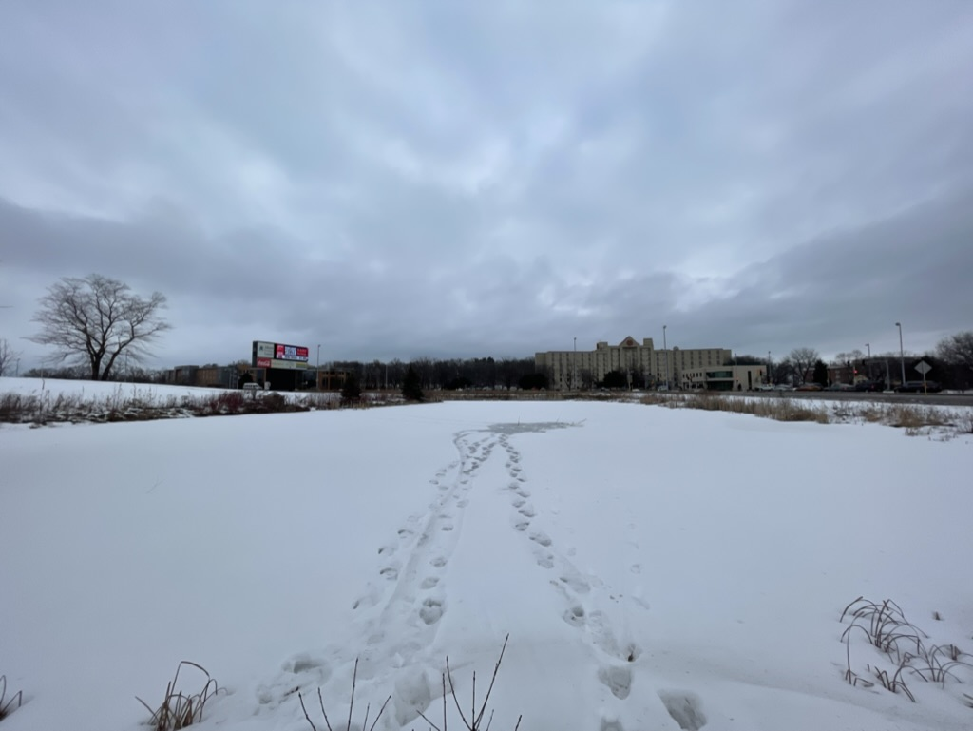
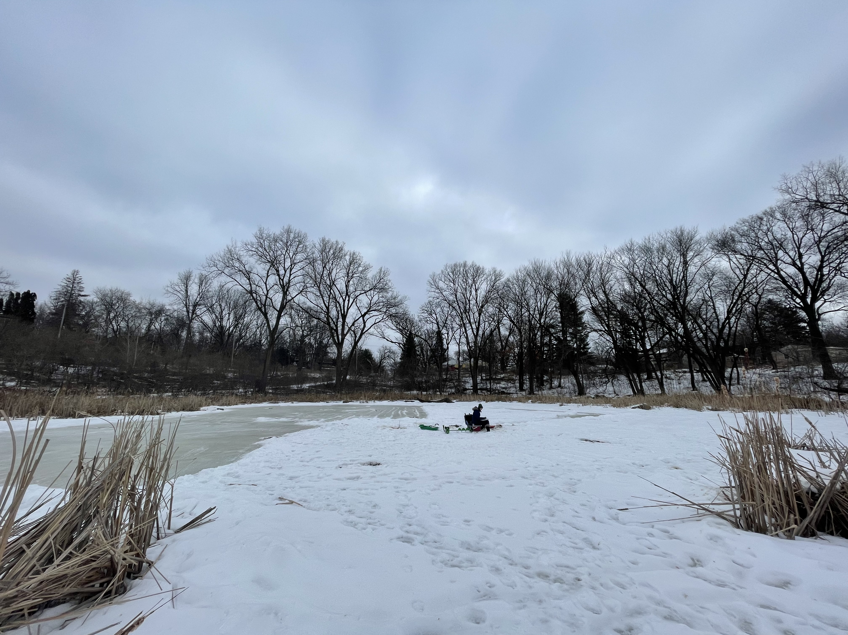
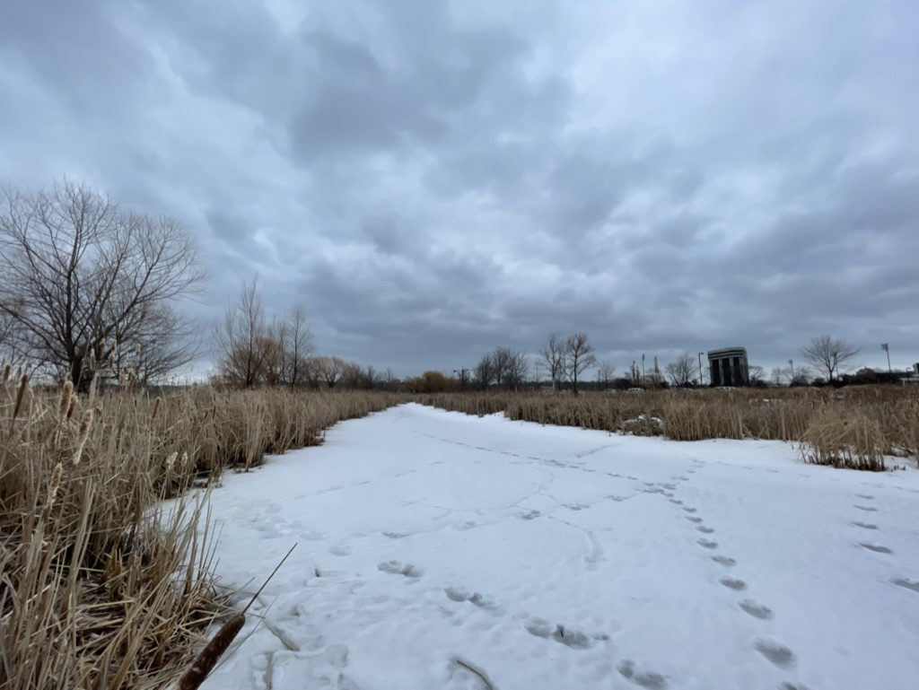
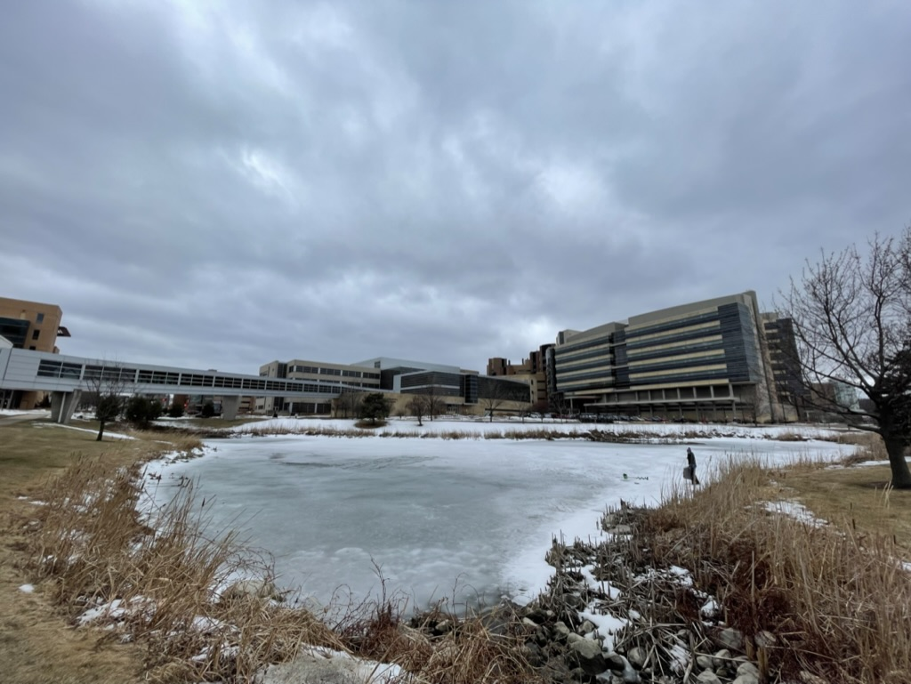
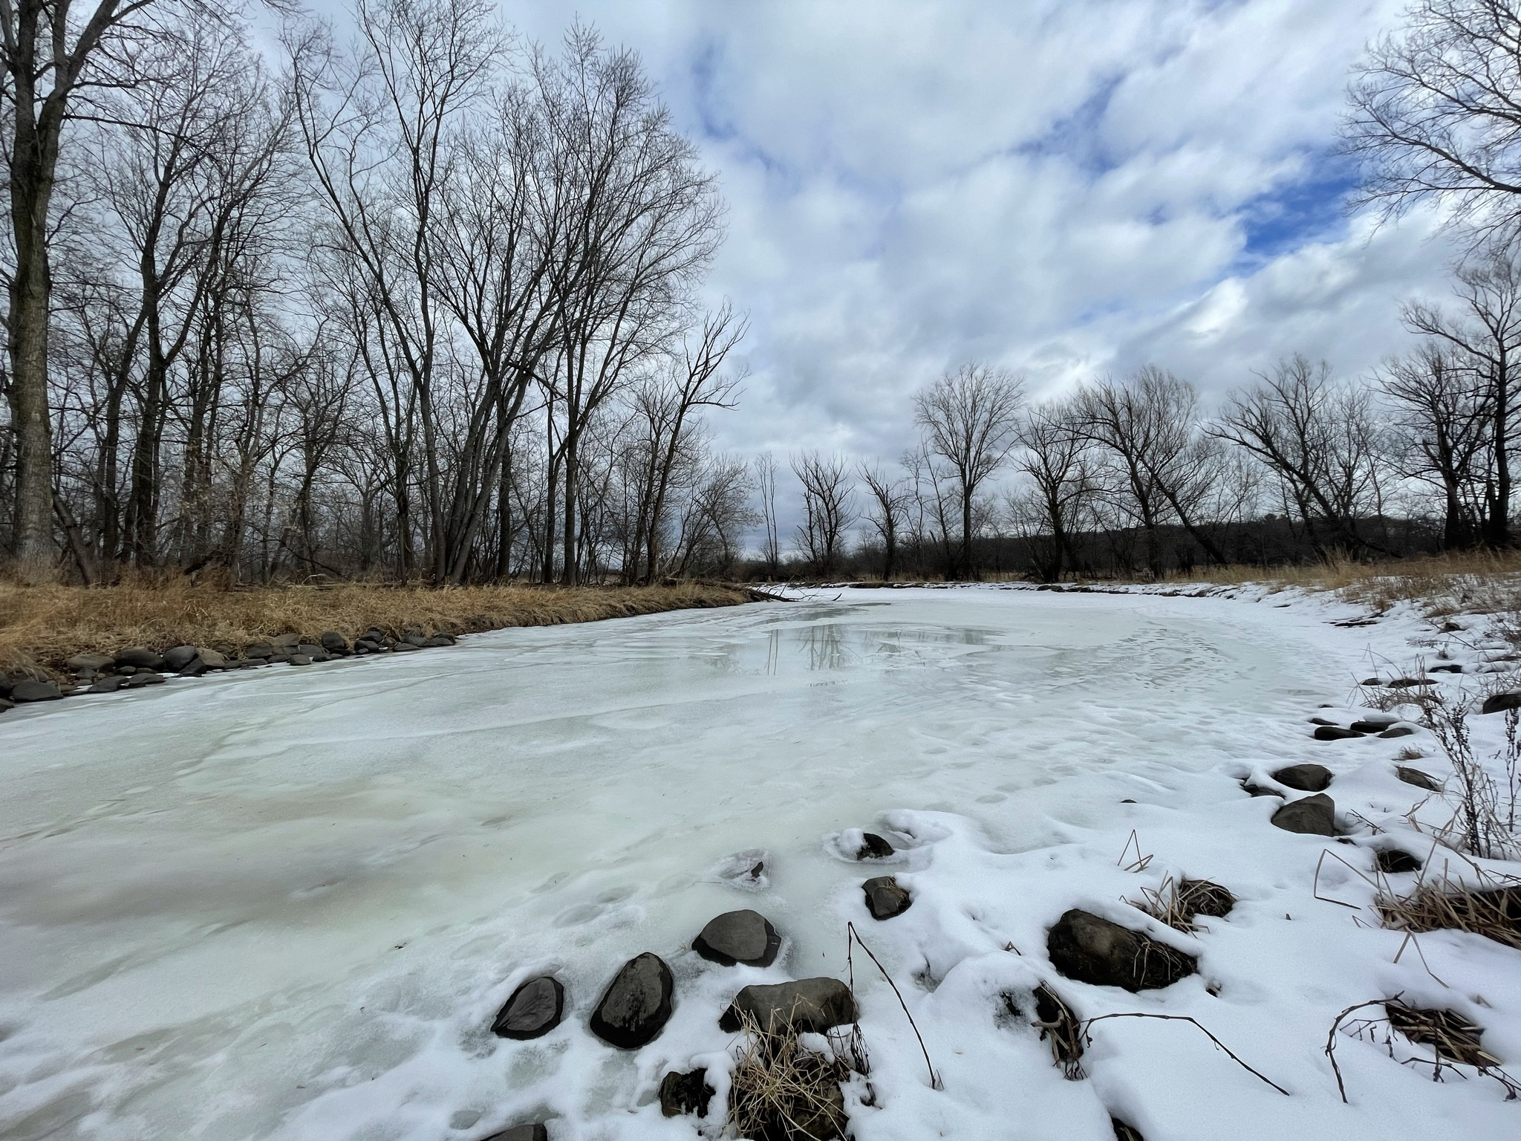
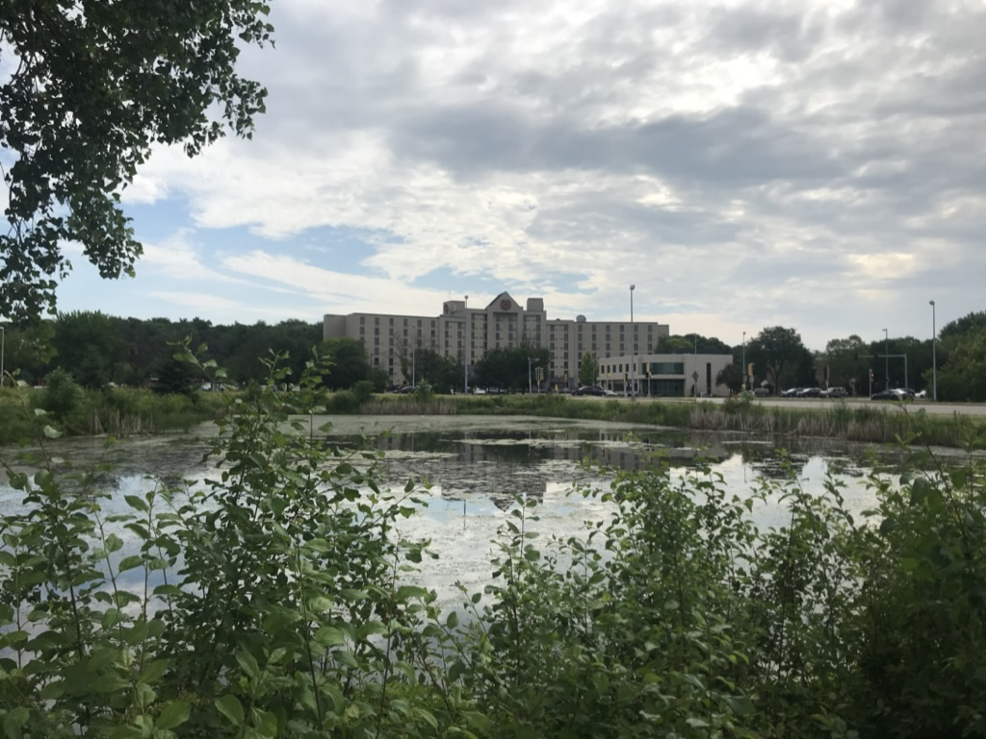
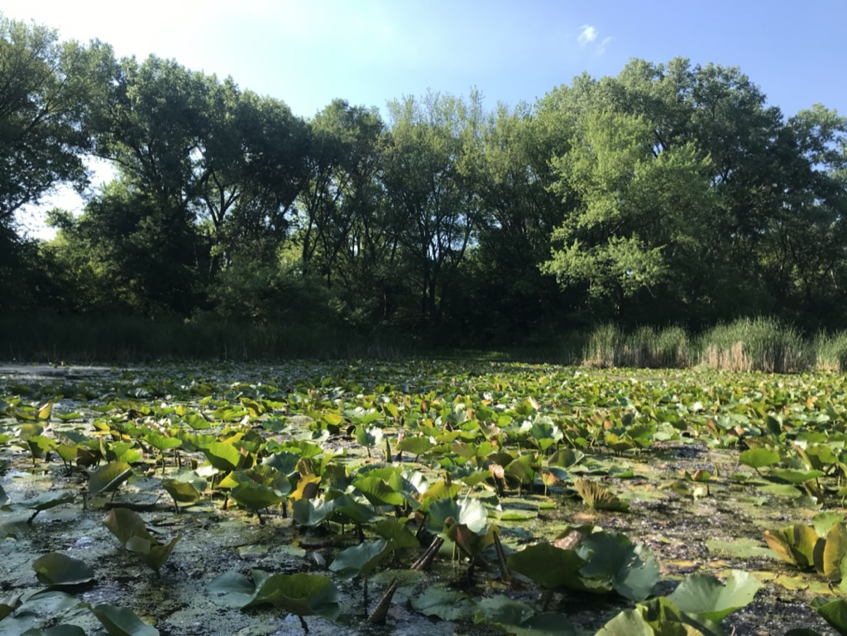
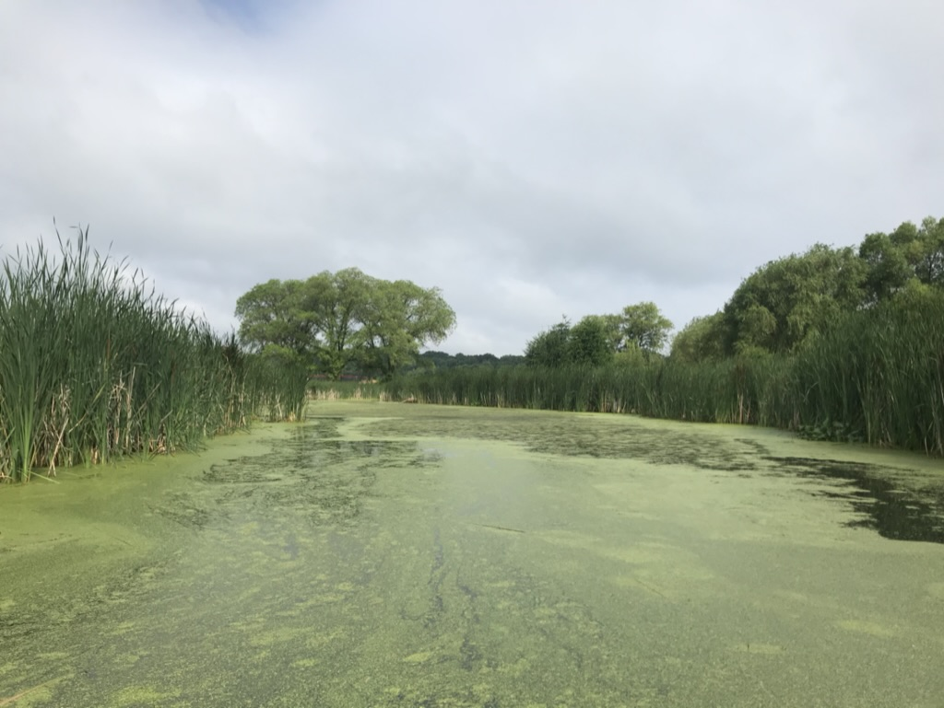
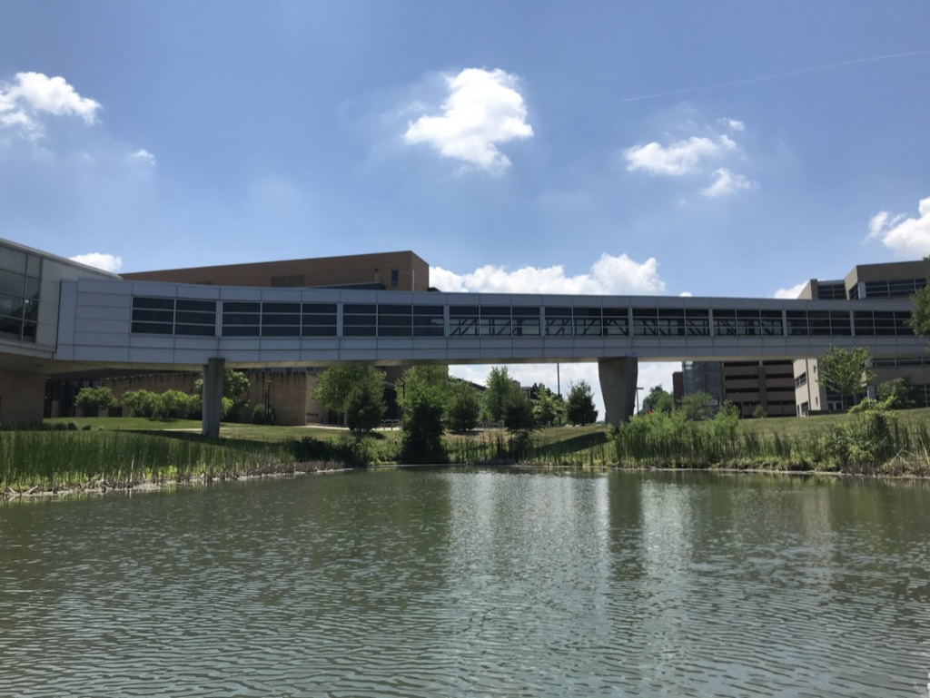
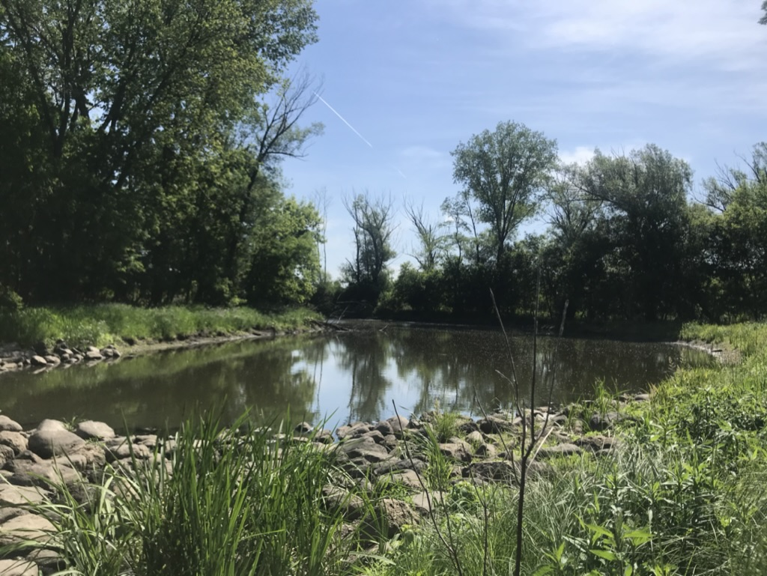
Seasonal Variability of Greenhouse Gases in Urban Ponds
Adrianna Gorsky, Hilary Dugan and Emily Stanley
Center for Limnology- University of Wisconsin-Madison
@agorsky
Urban freshwater ecosystems: multiple stressors and manifold opportunities

Slide 2
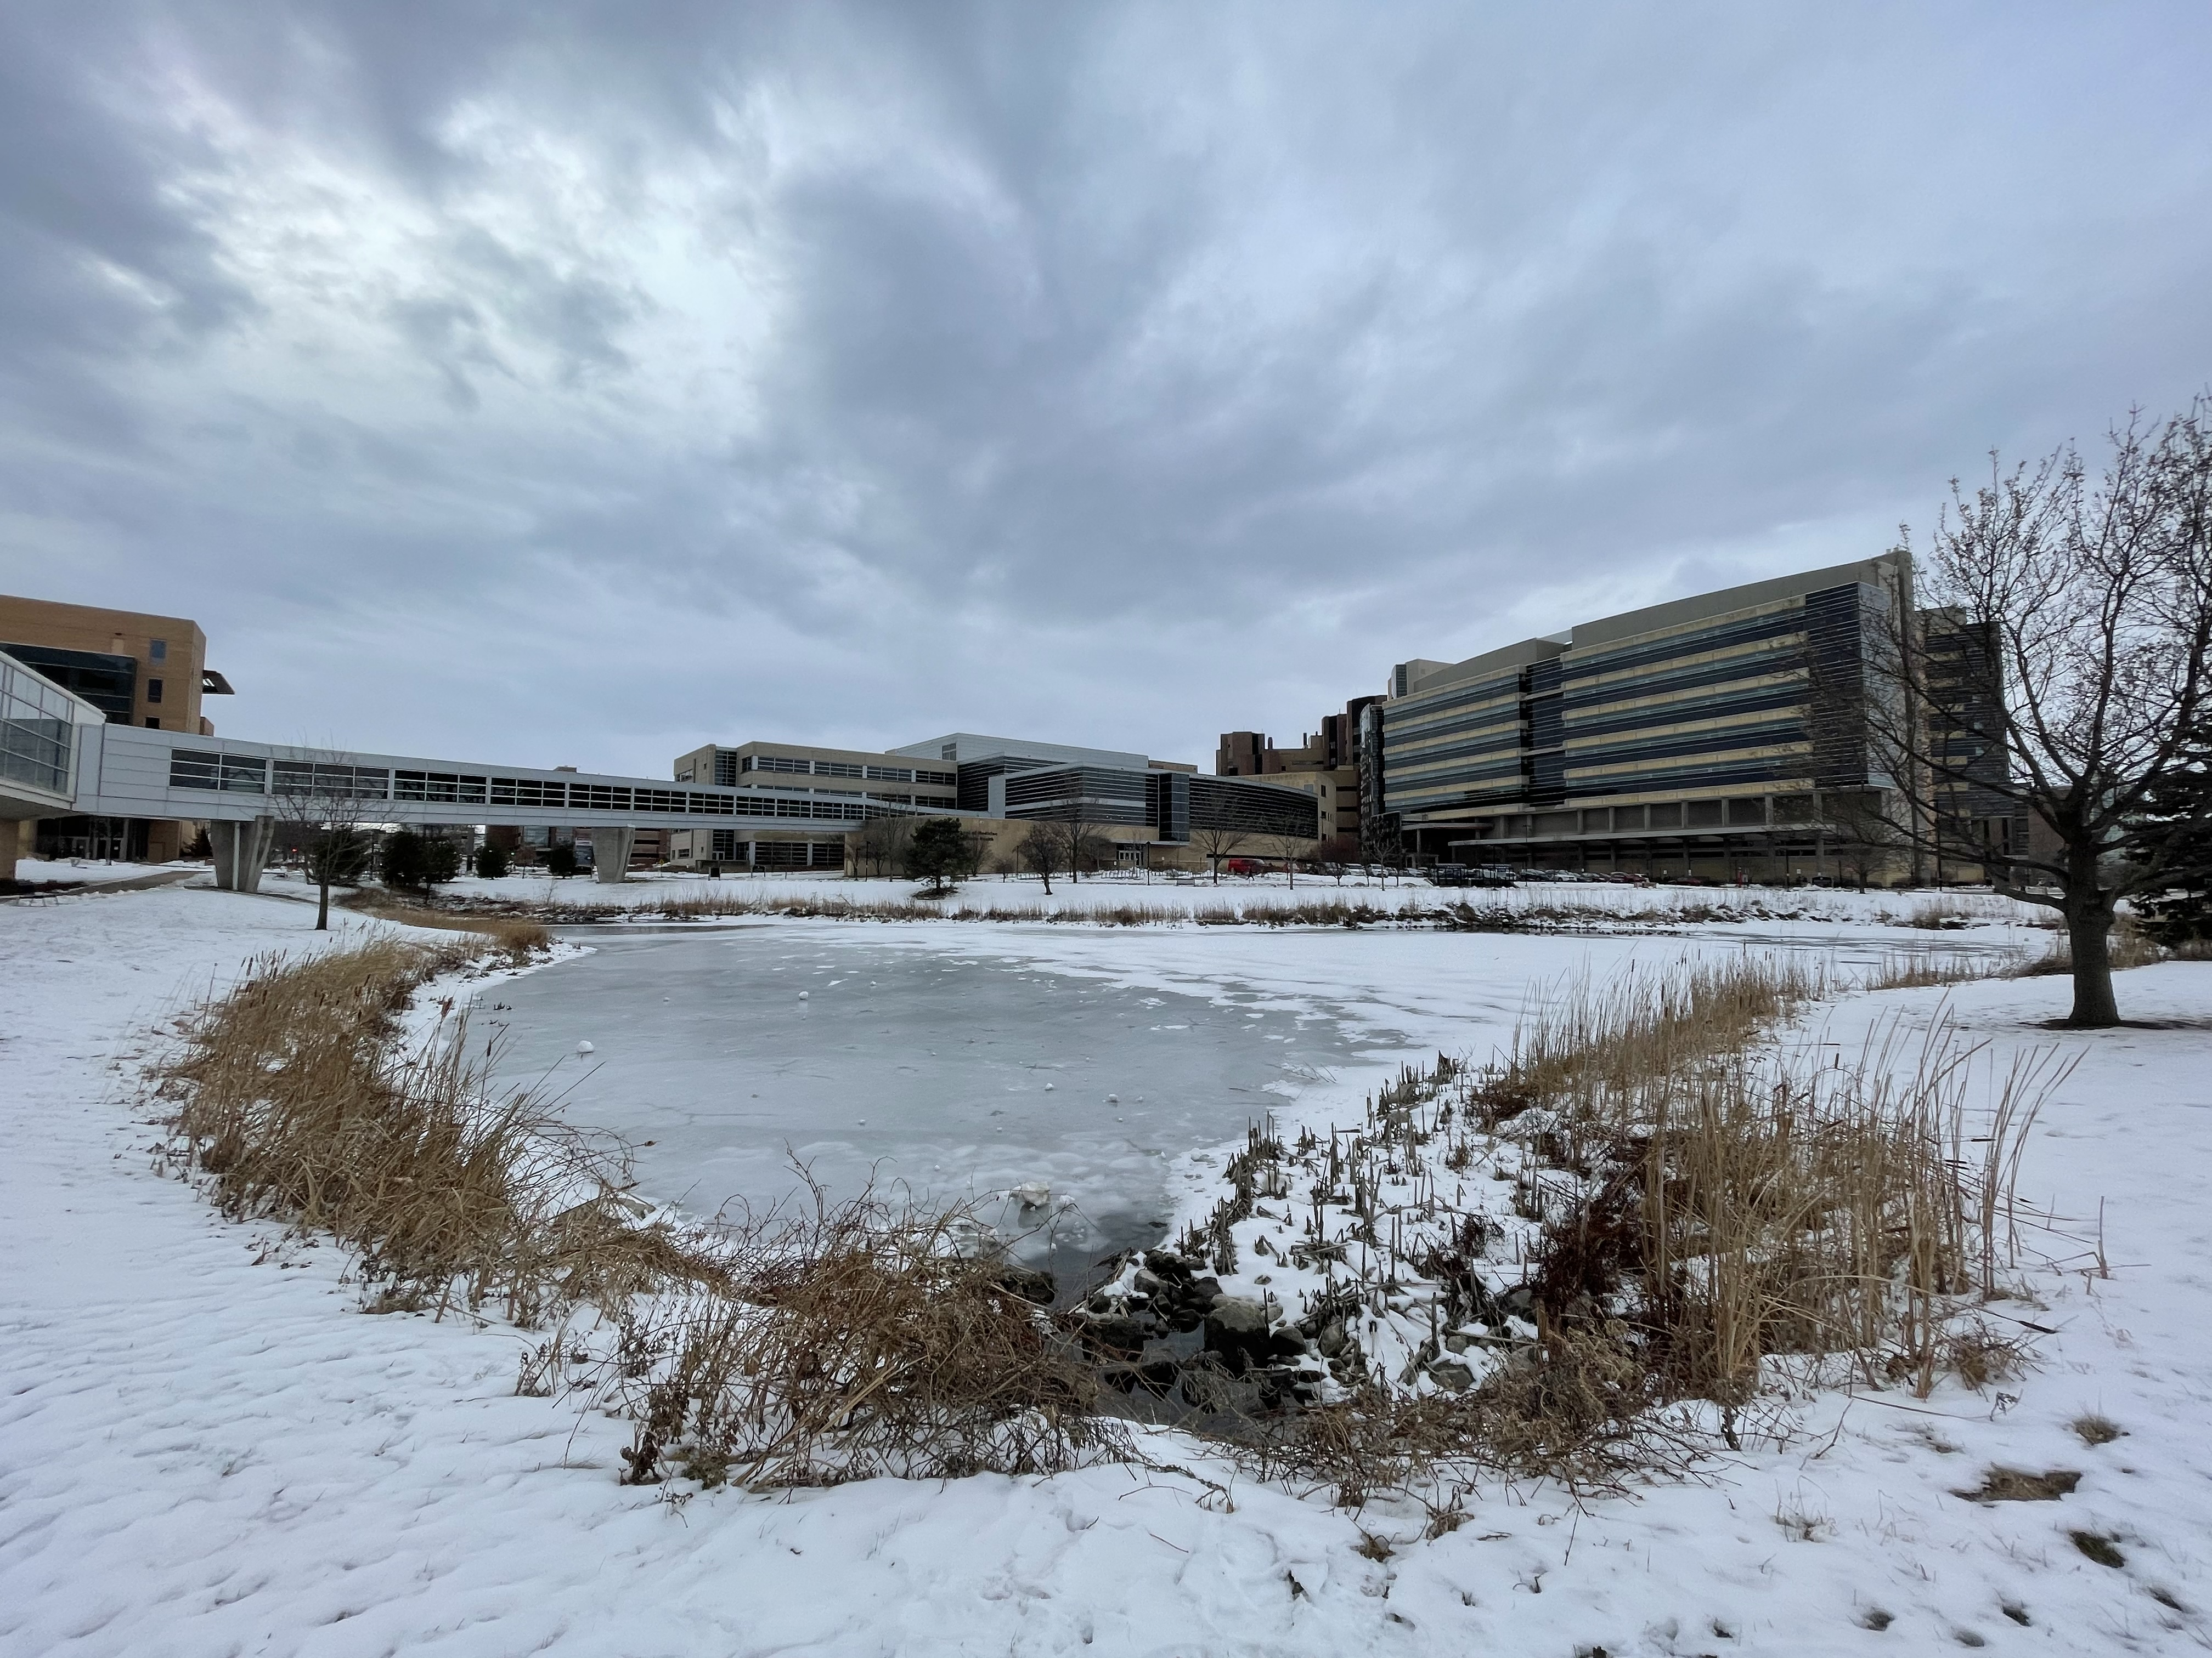
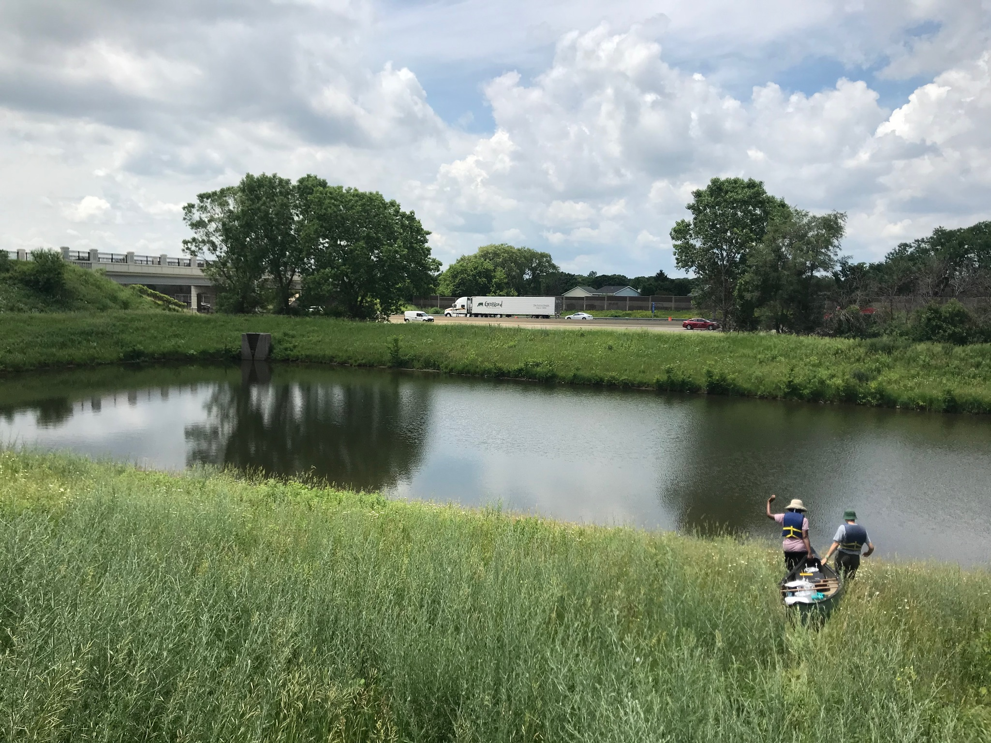
Historical focus on summer
Variability of urban ponds
How do urban ponds experience winter?
Explore heterogeneity across seasons
Notes:
Overestimation
wide range of environmental conditions present in an urban pondscape and the isolation of urban ponds at both a local scale (within urban settlements) and a regional scale (among urban settlements)

Slide 3
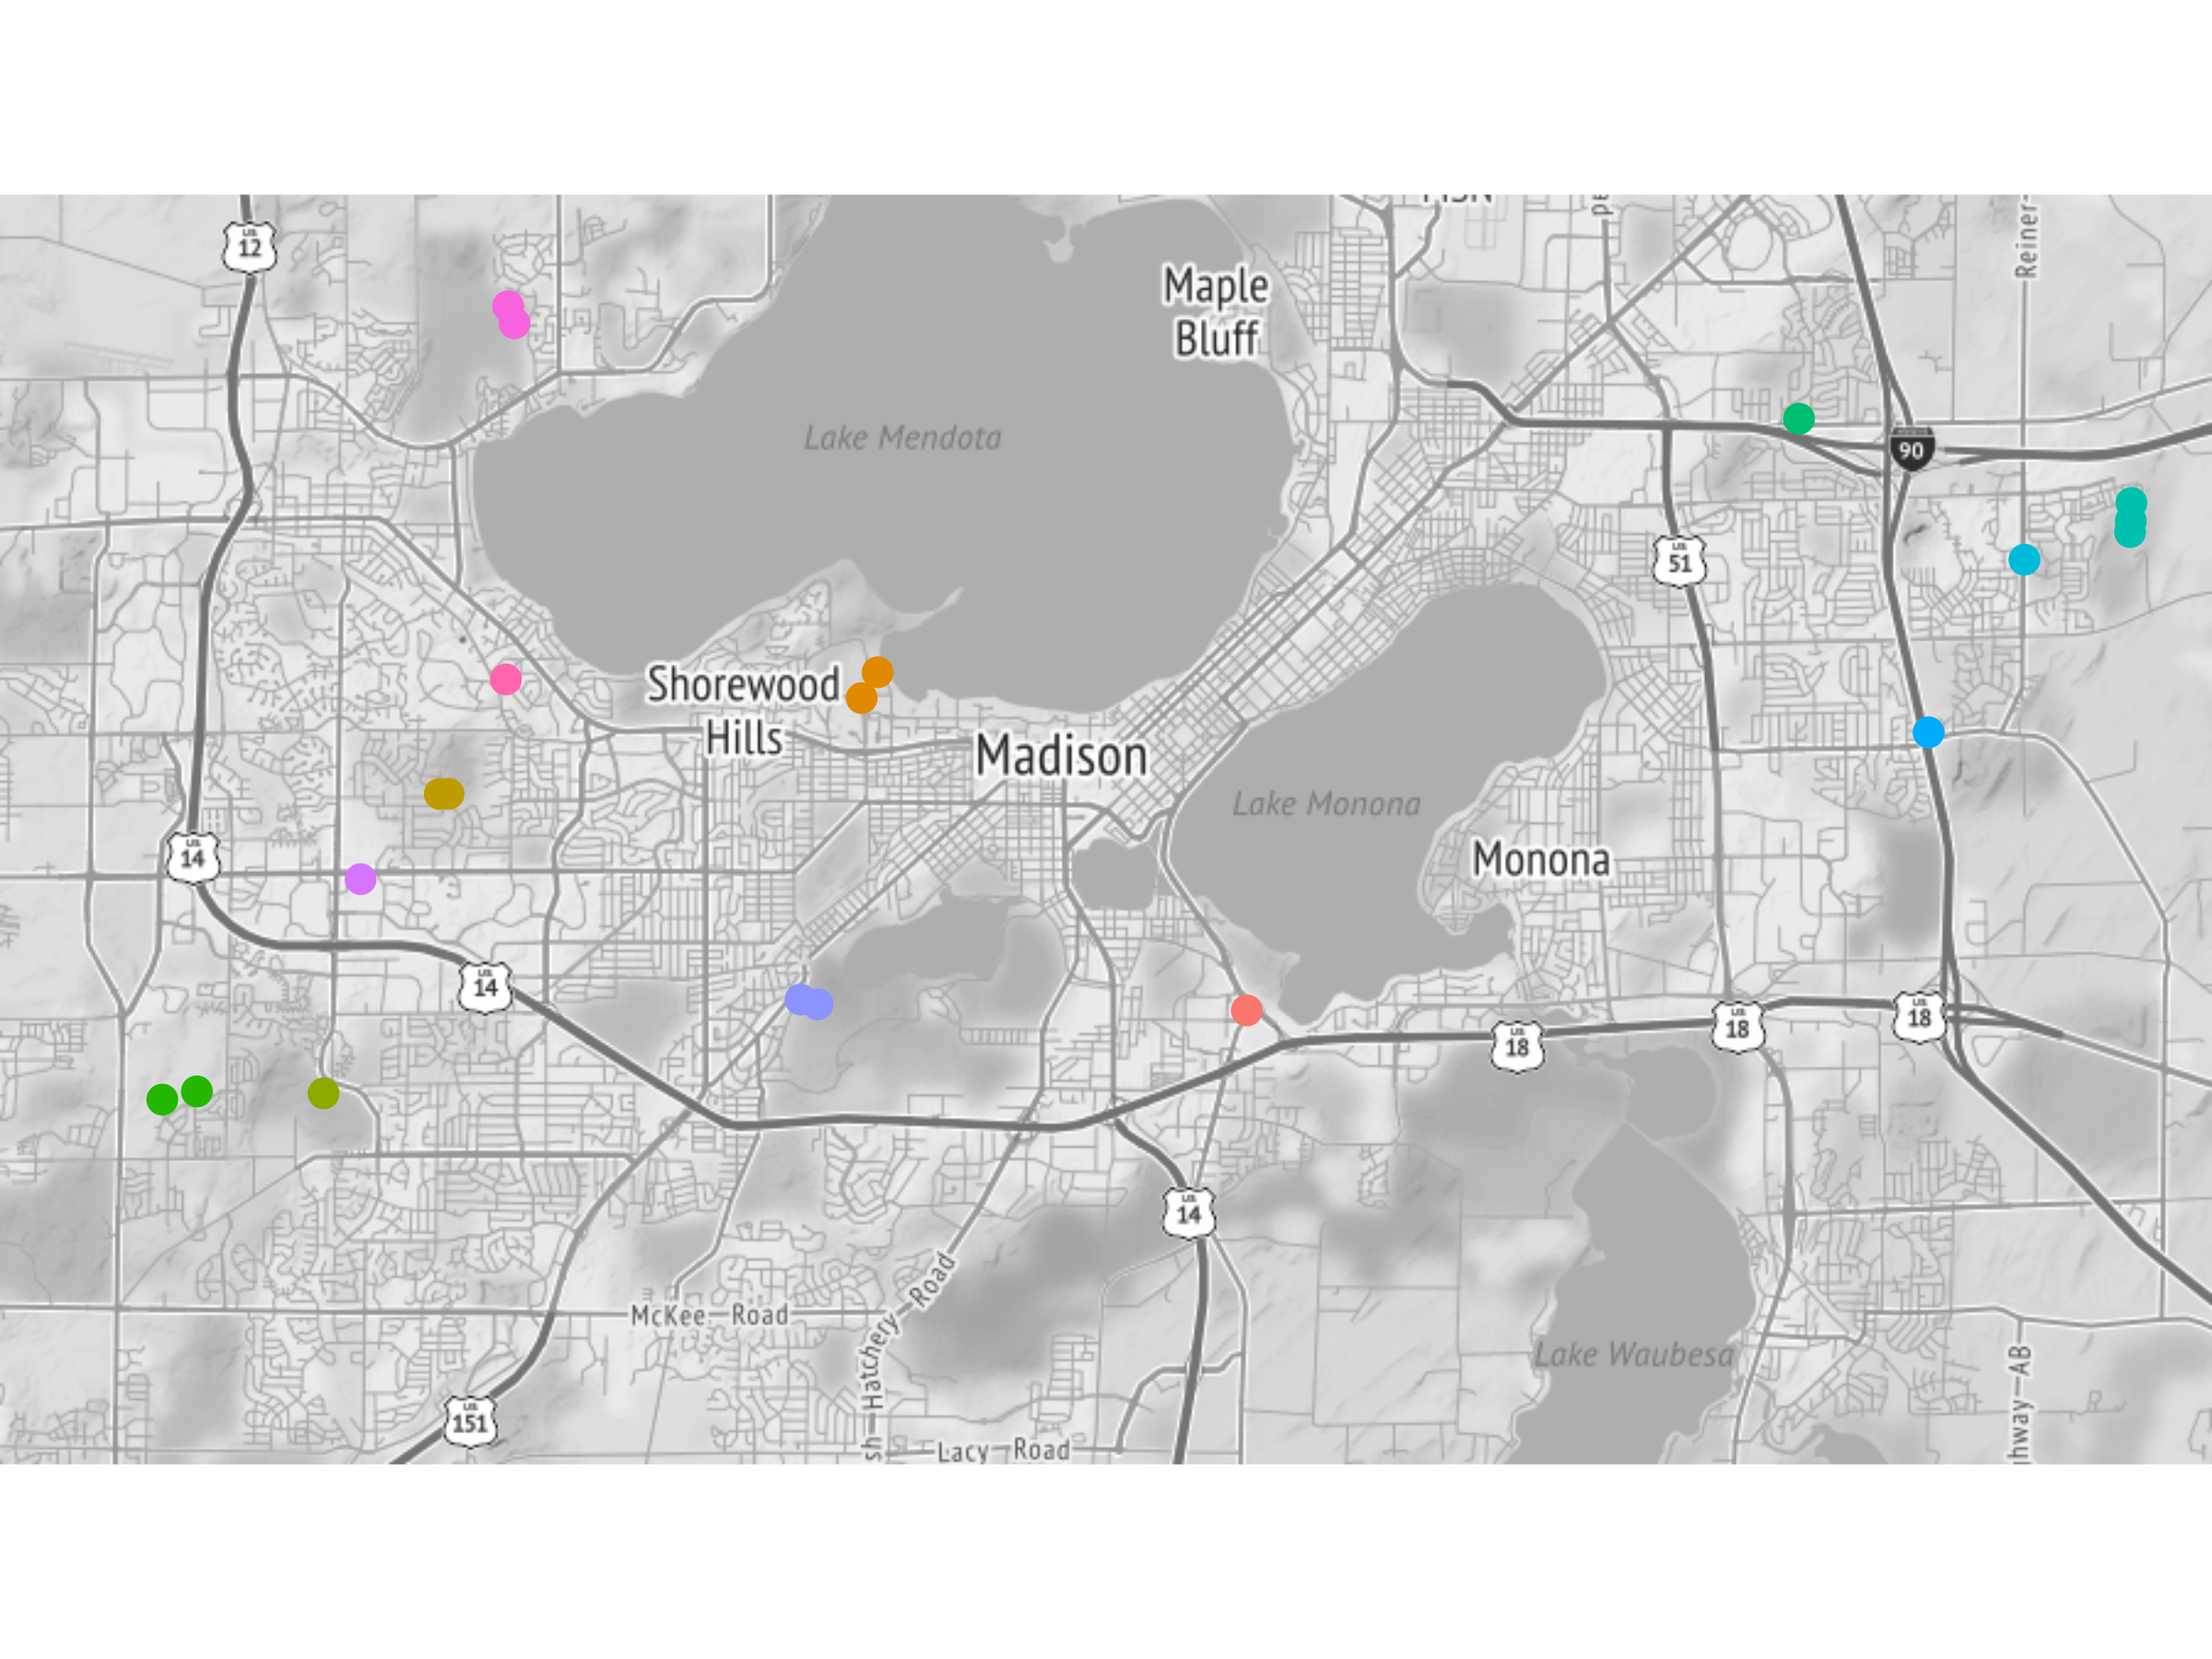
Summer 2021 and Winter 2022
20 ponds
Surface Area (ha)
Range: 0.14- 1.01
Median: 0.4
Sampling Depth (m)
Range: 0.7-3
Median: 1.6
Notes:
The city of Madison, Wisconsin, and its surrounding suburbs, is representative of many midwestern landscapes that are influenced by both urban and agricultural stressors.

Slide 4
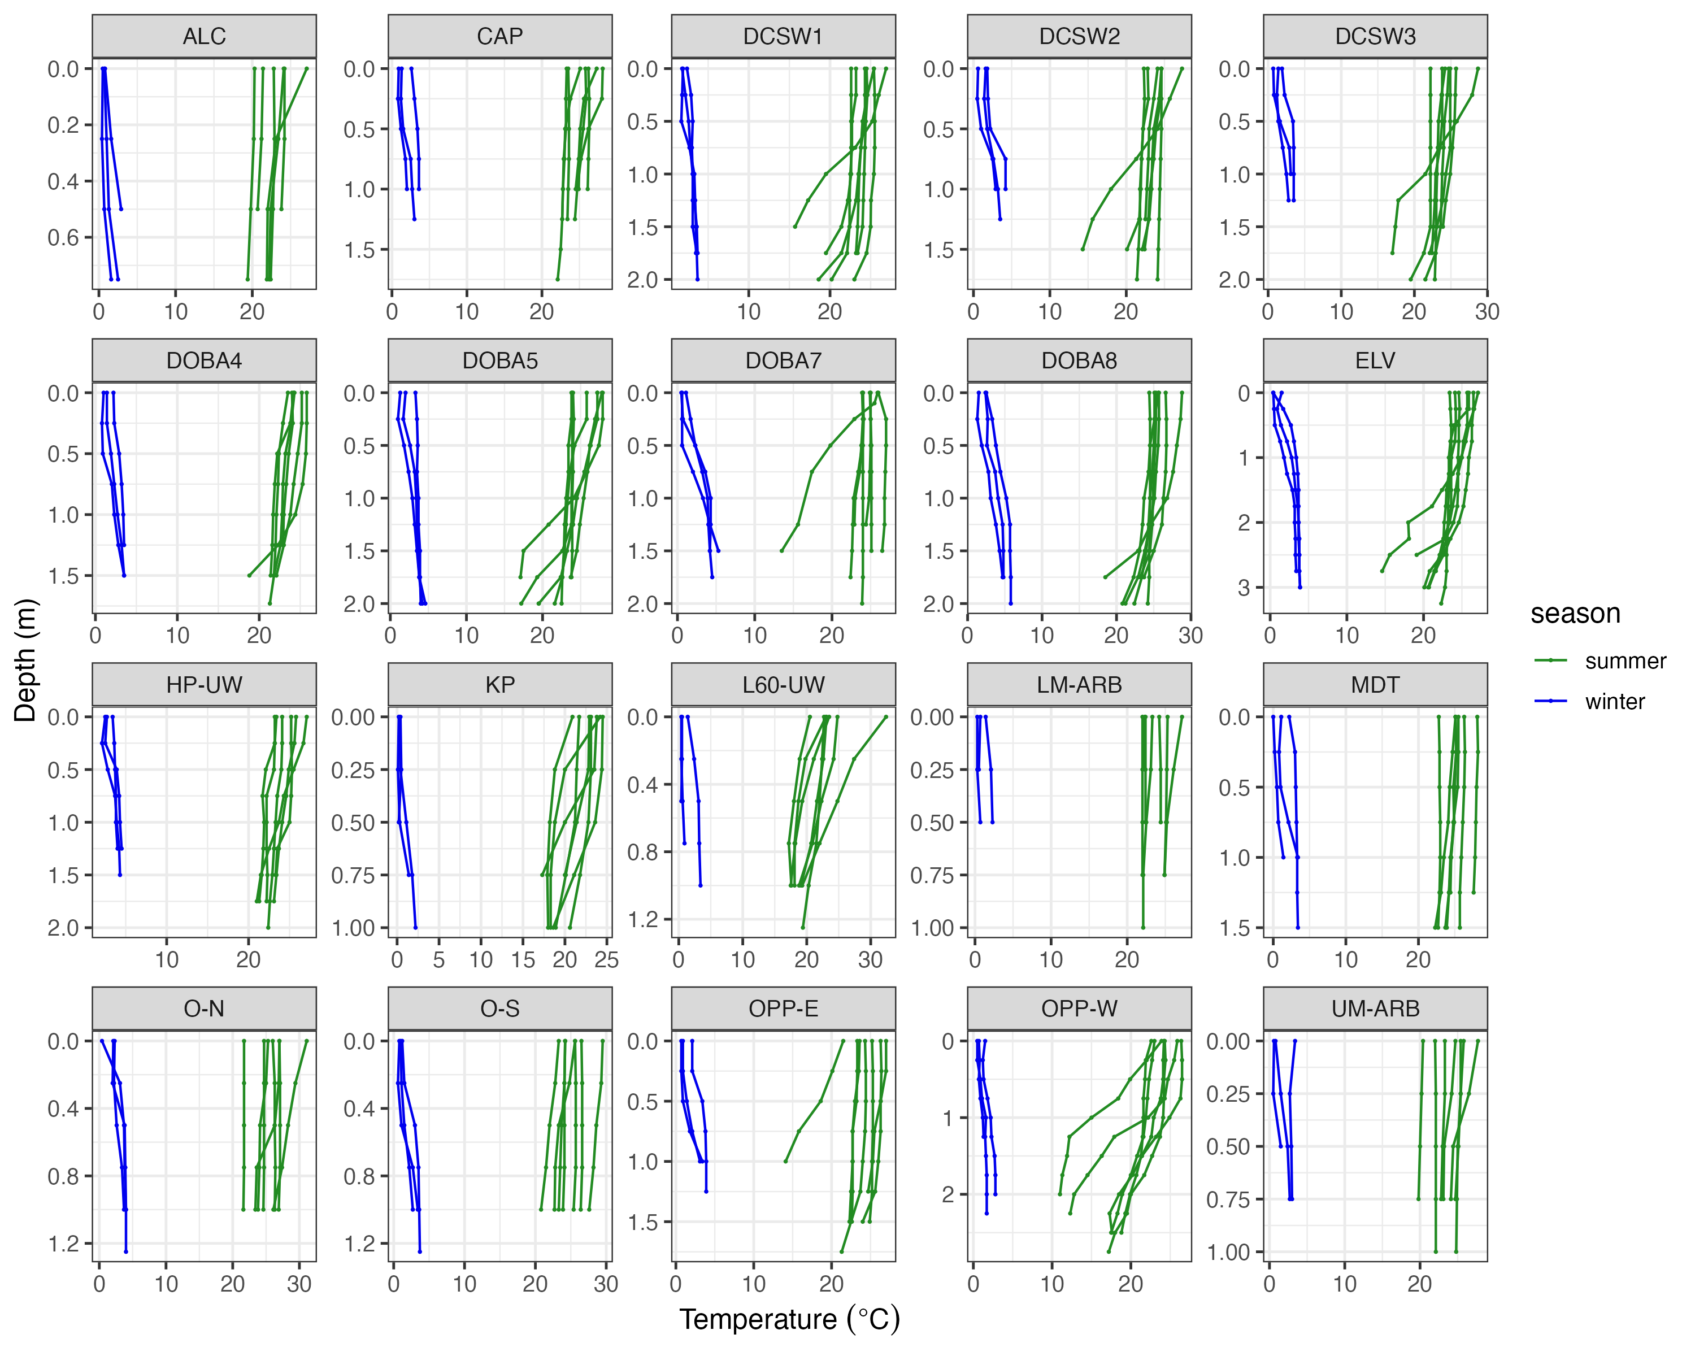
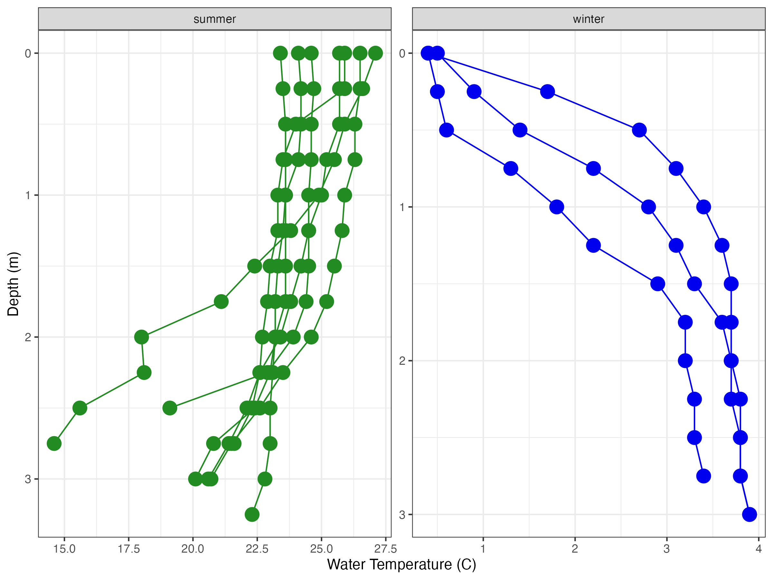
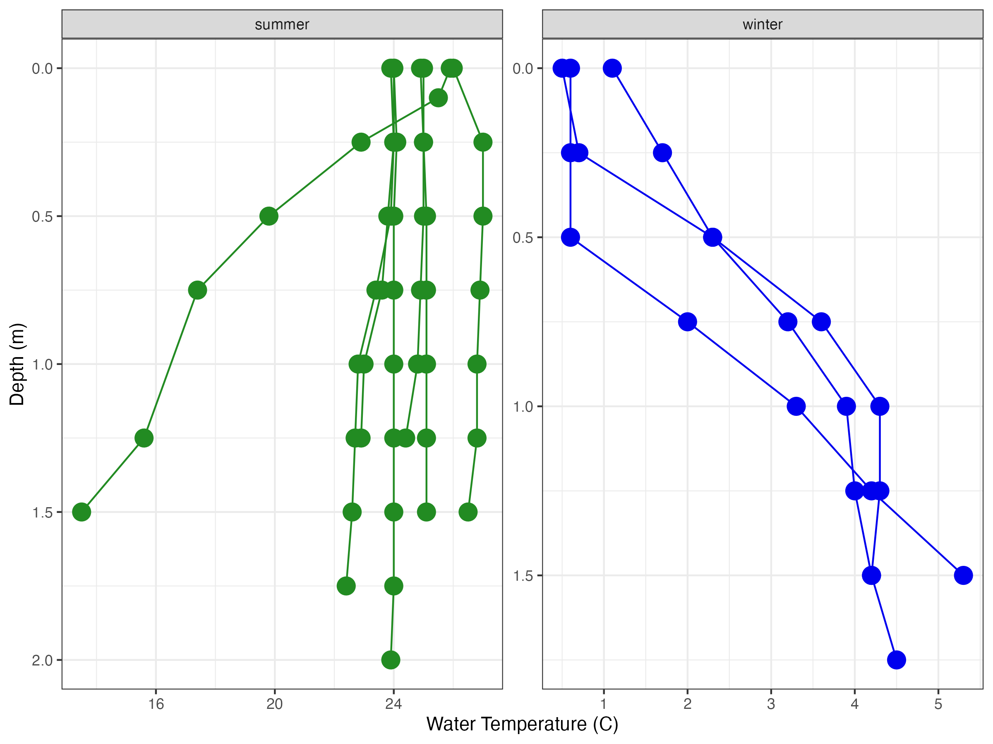
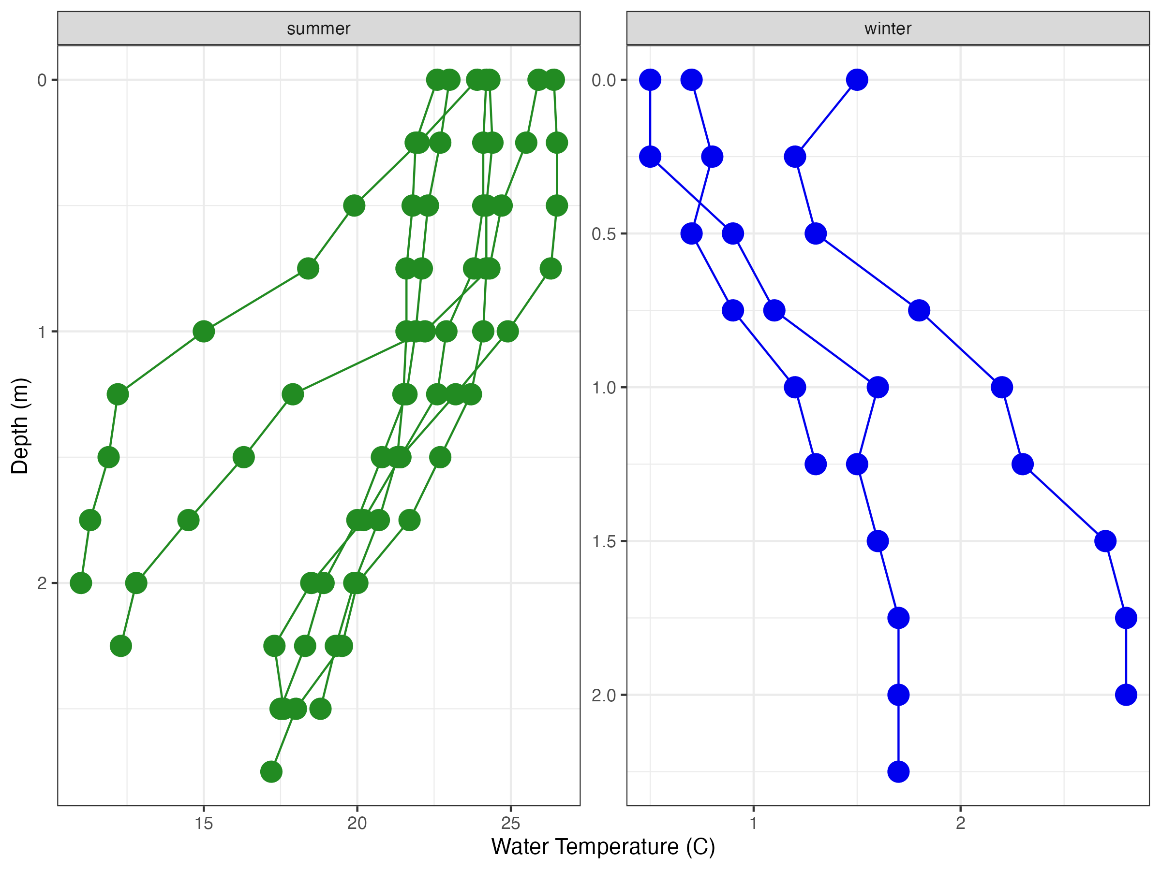

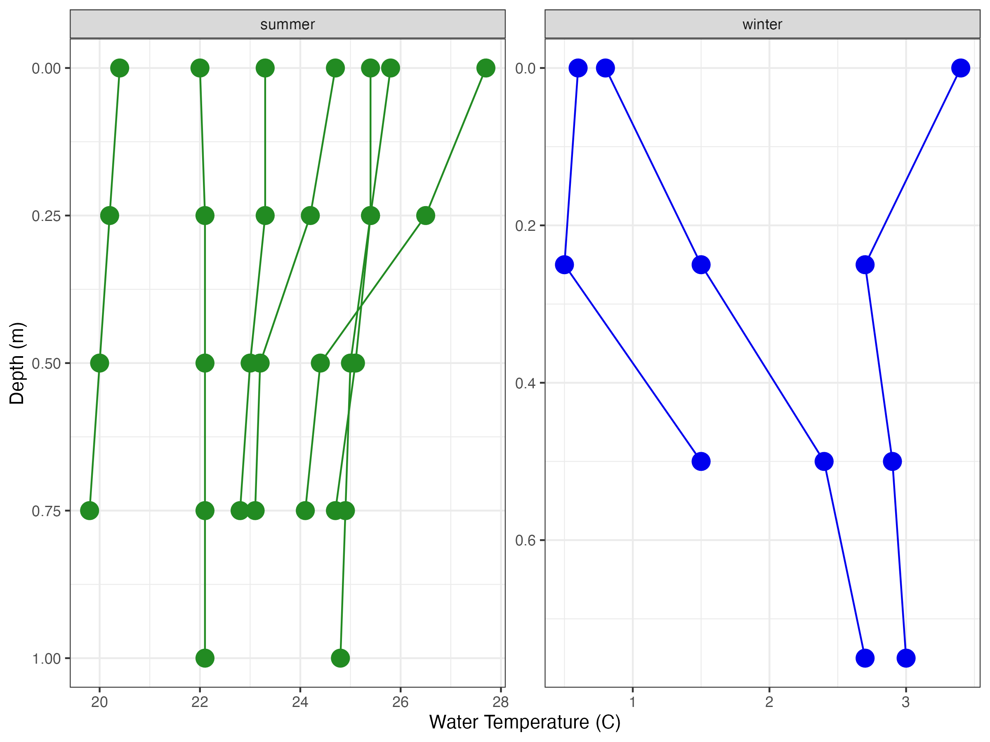
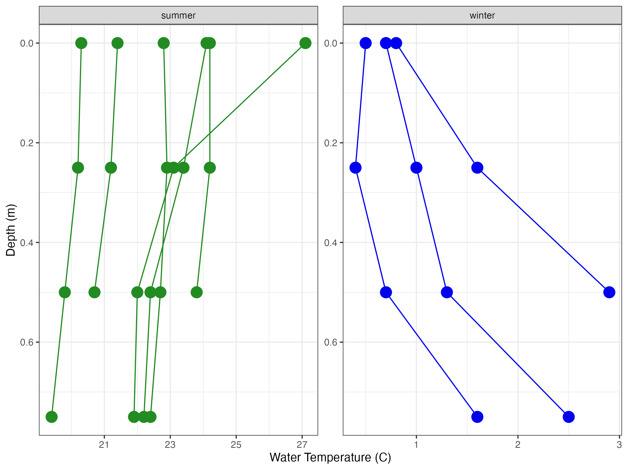
Nutrient Cycling
Oxygen availability
Gas exchange
Notes:
Ponds have been assumed to be well mixed systems with isothermic conditions and a similar water chemistry throughout the water column.

Slide 5
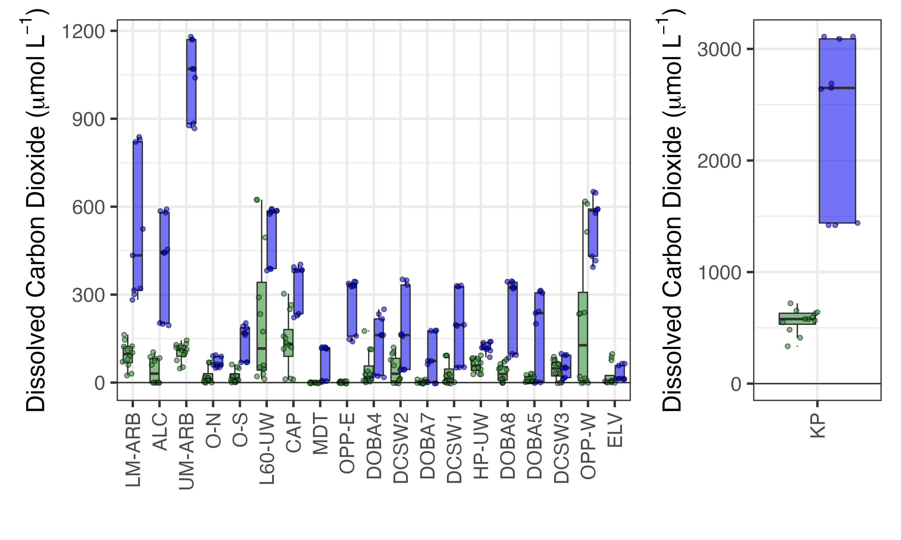


CO₂ (µmolL⁻¹)
Range: 0-720
Mean: 85
CO₂ (µmolL⁻¹)
Range: 0-3110
Mean: 378
0.75m
3.0m
Pond Depth

Slide 6
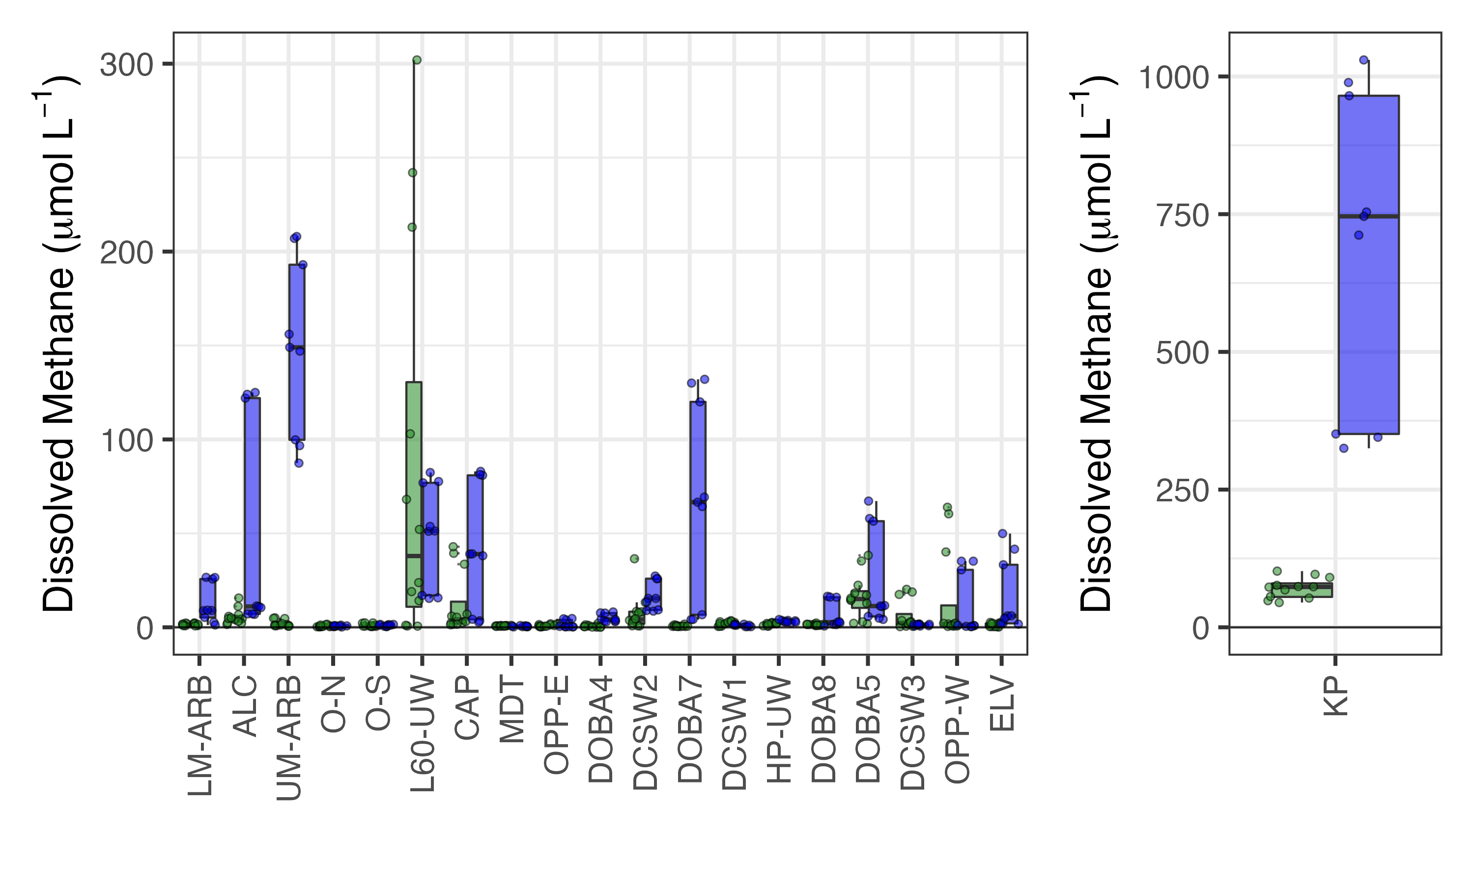
CH₄ (µmolL⁻¹)
Range: 0.01-302
Mean: 12
CH₄ (µmolL⁻¹)
Range: 0.1-1030
Mean: 57
0.75m
3.0m
Pond Depth

Slide 7
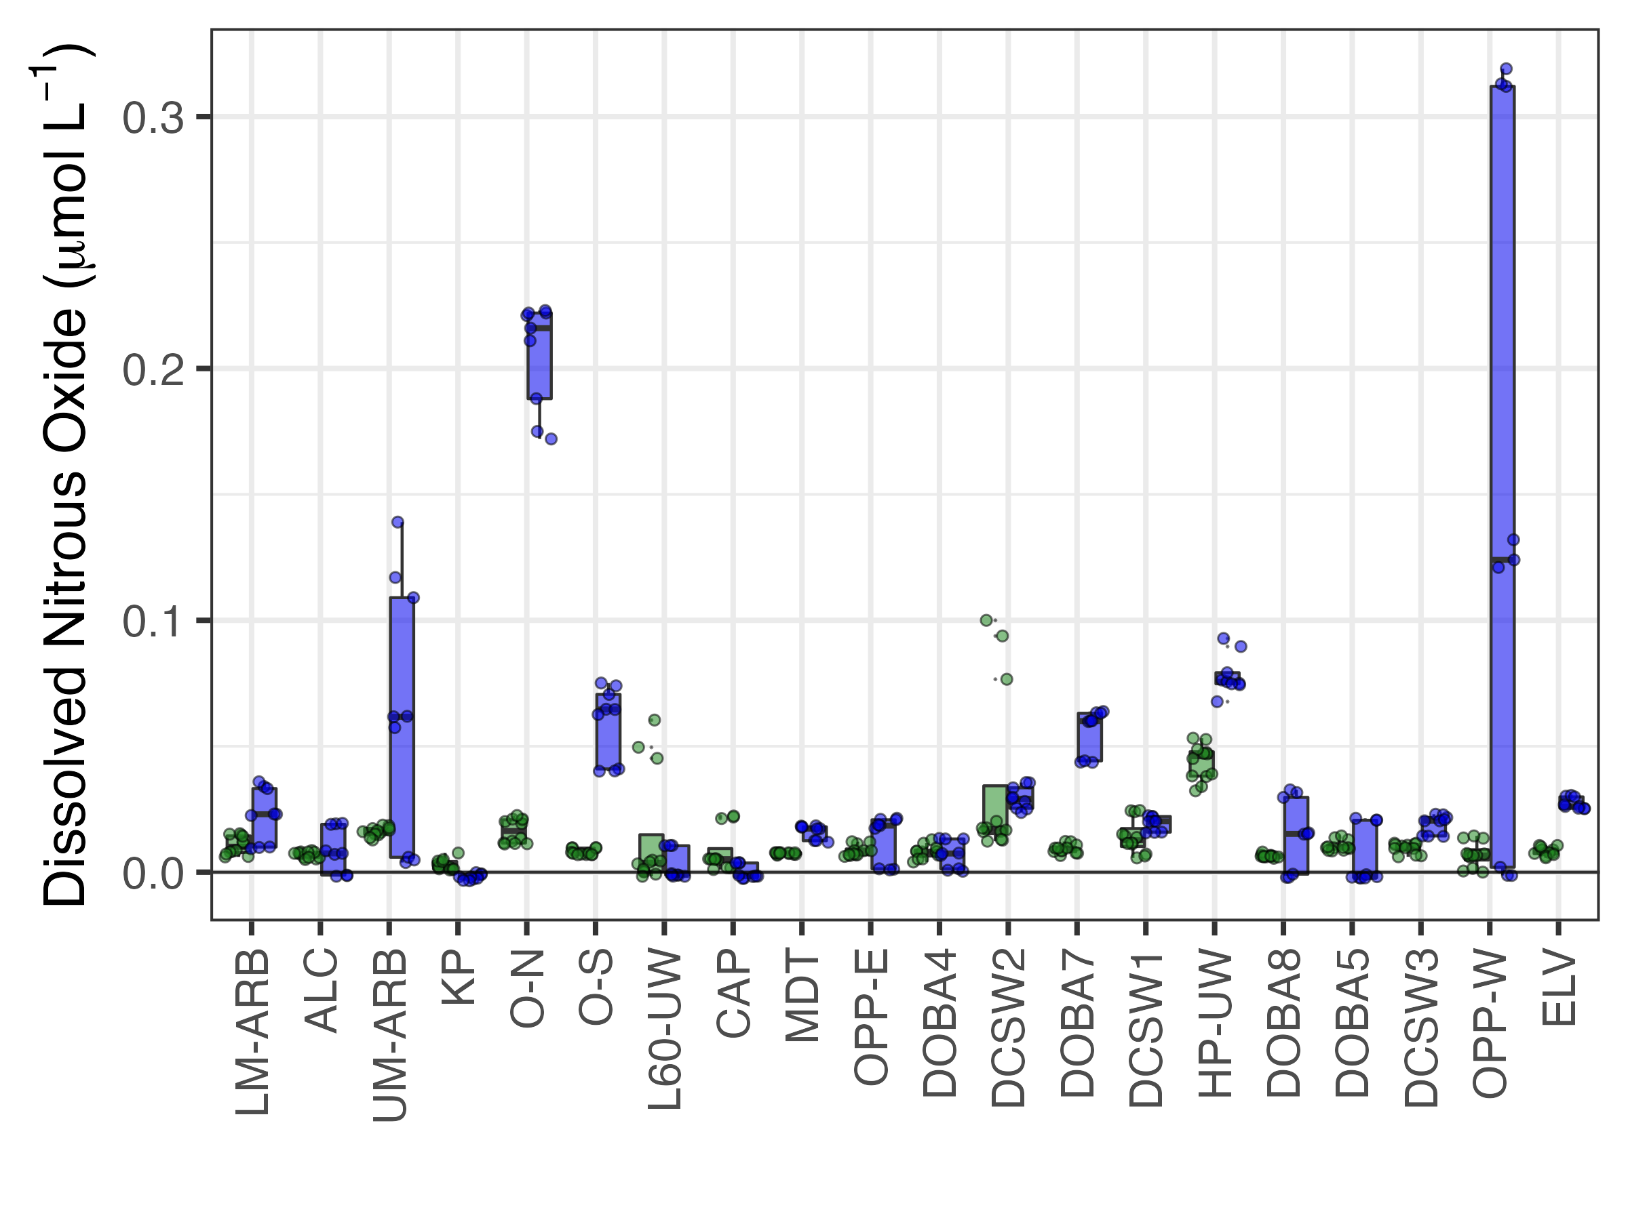
N₂O (µmolL⁻¹)
Range: 0-0.1
Mean: 0.01
N₂O (µmolL⁻¹)
Range: 0-0.3
Mean: 0.04
0.75m
3.0m
Pond Depth

Slide 8
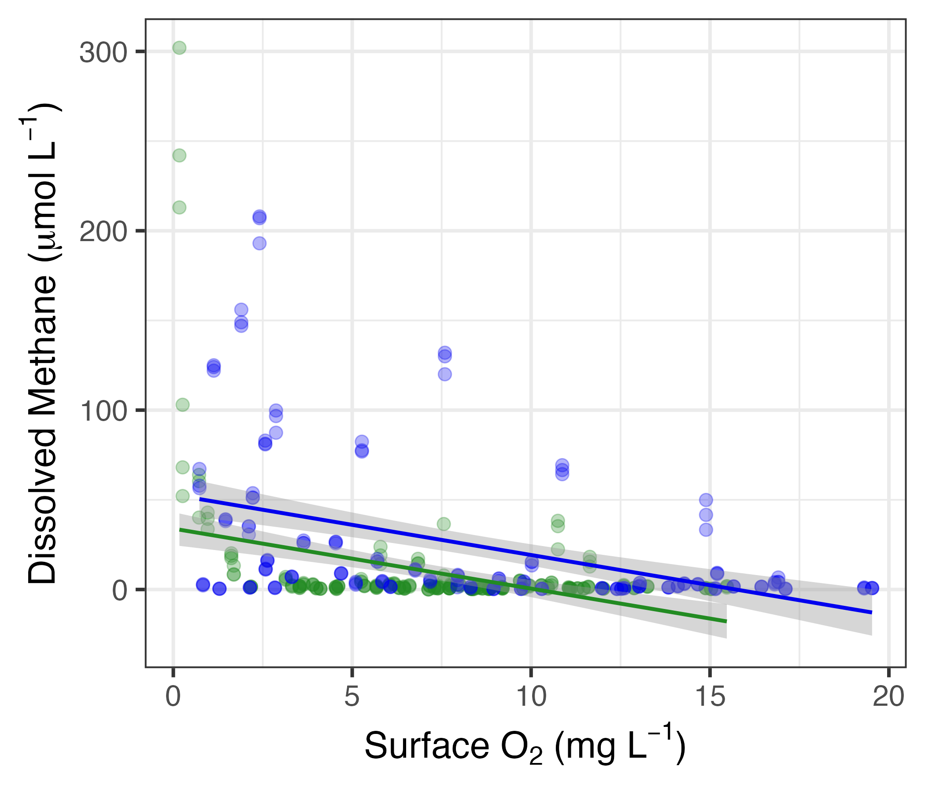
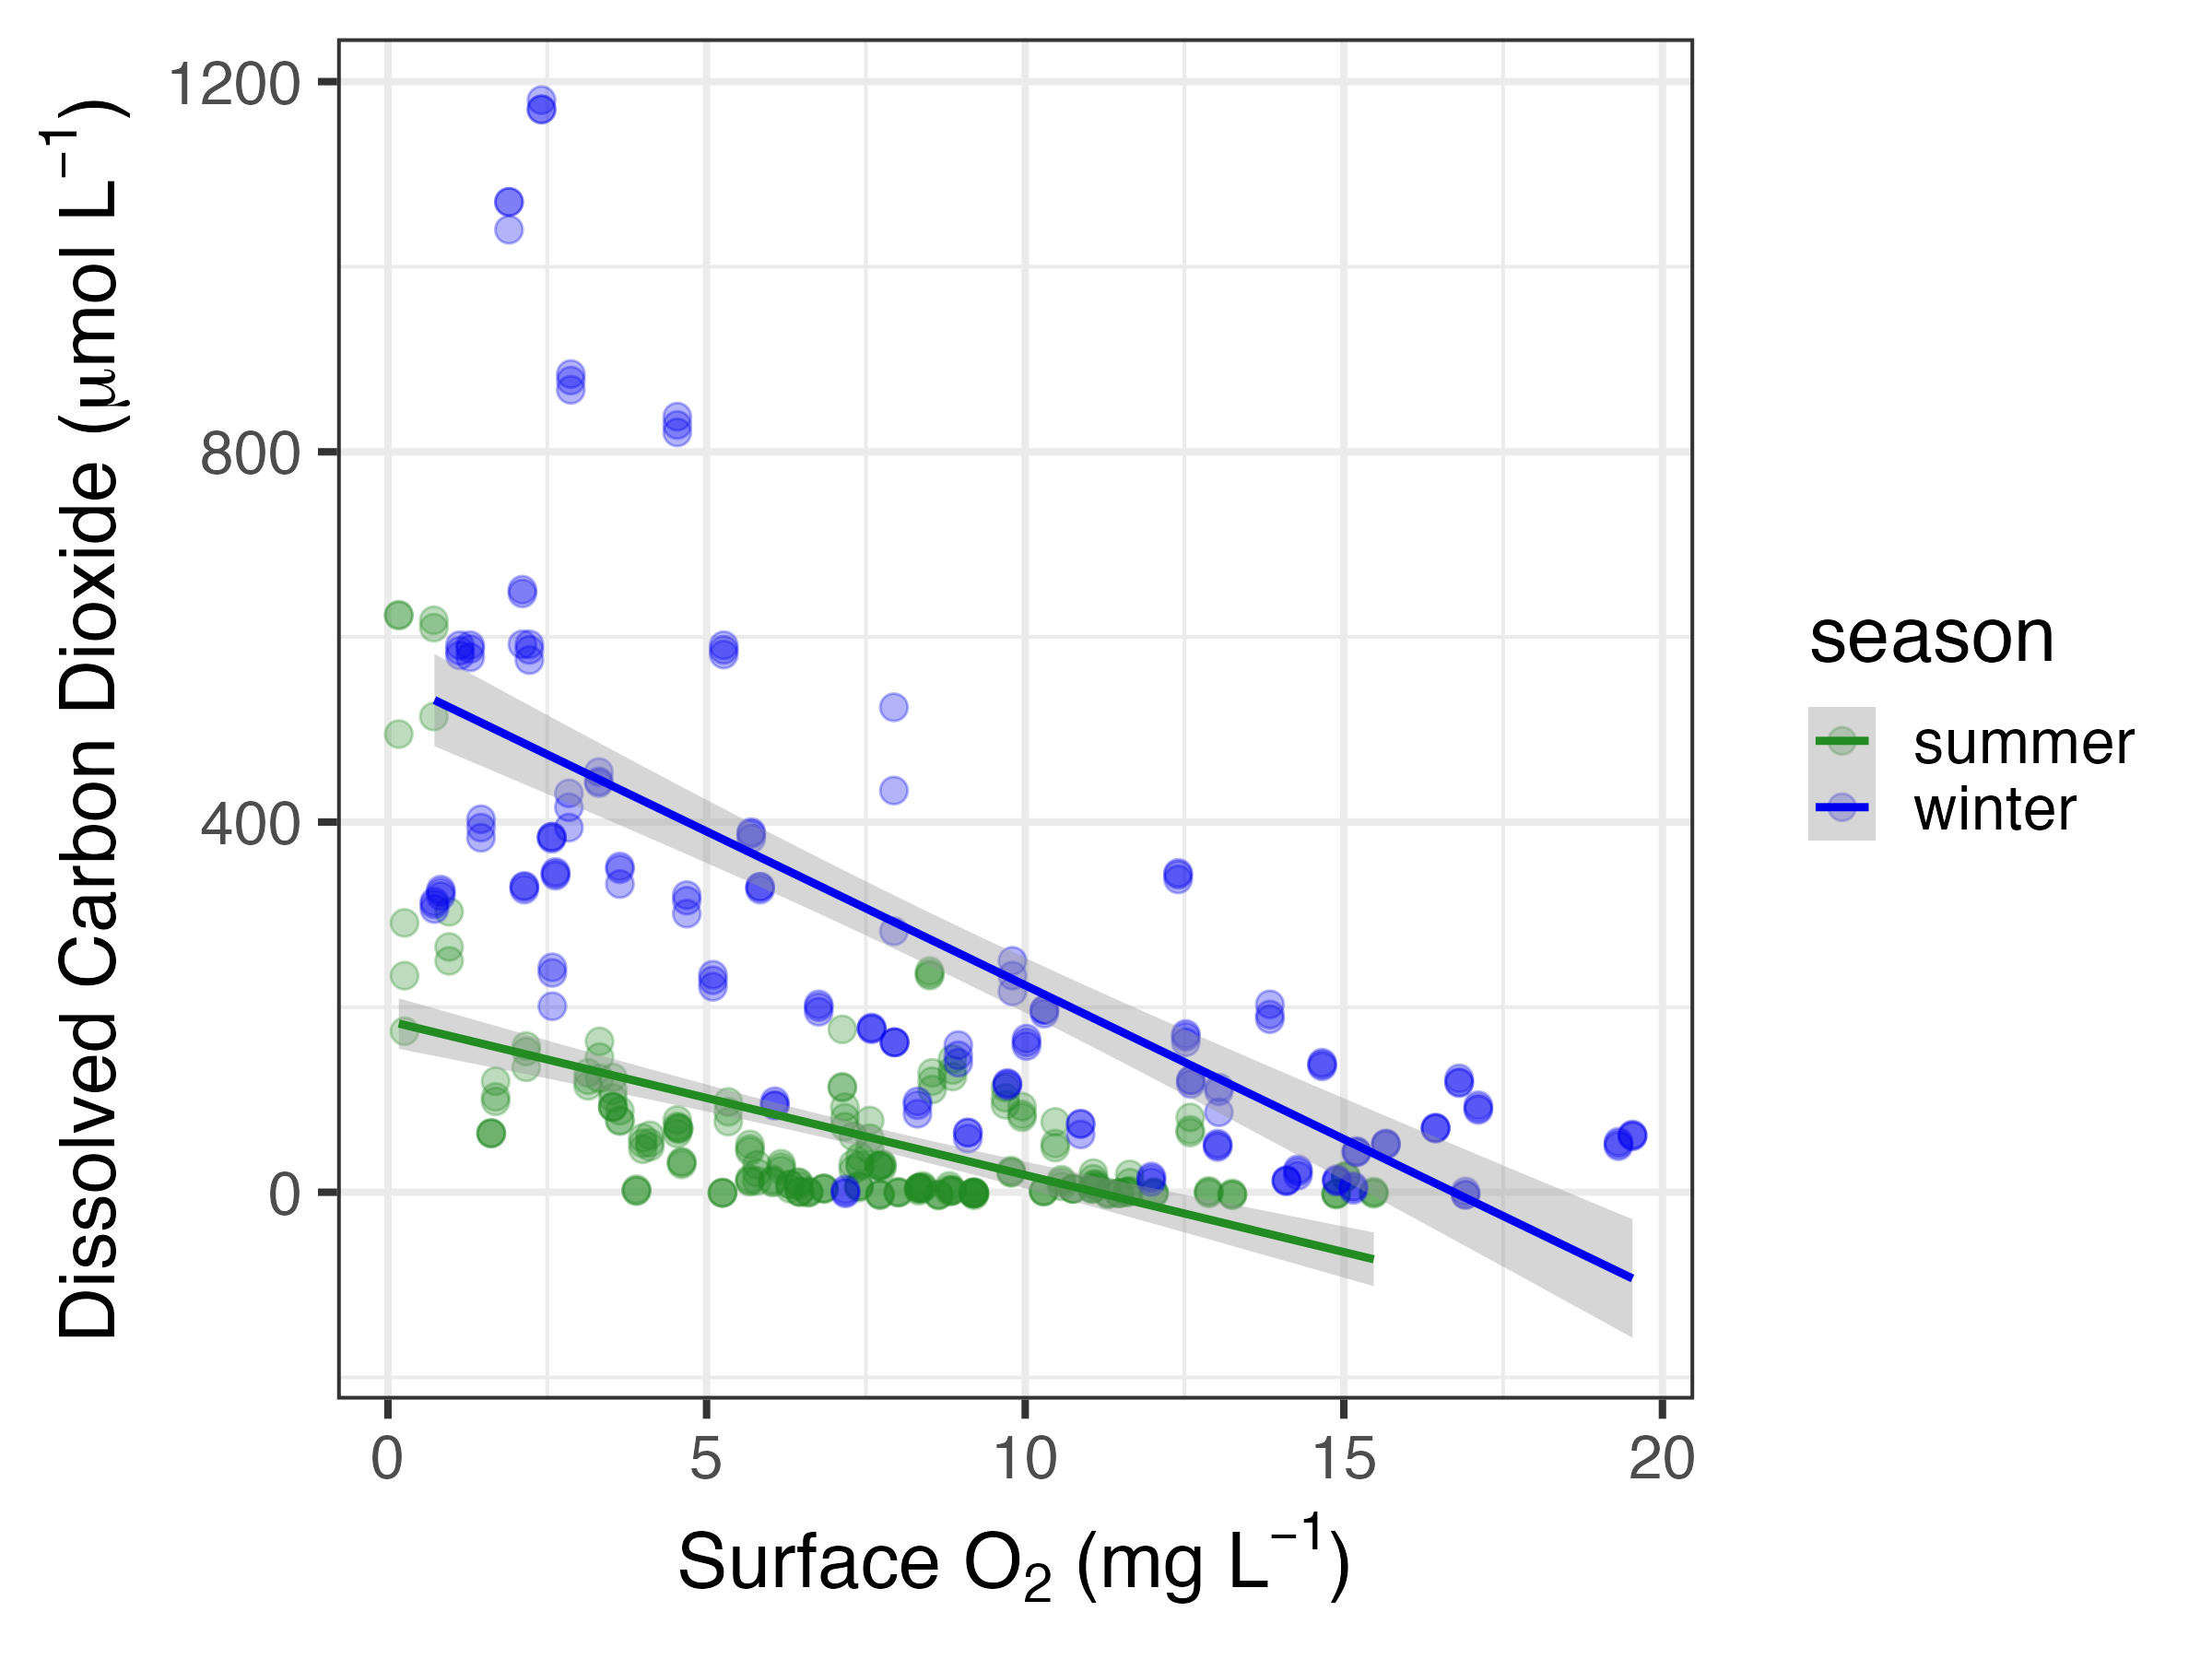
R² = 0.14
R² = 0.19
R² = 0.31
R² = 0.48

Slide 9
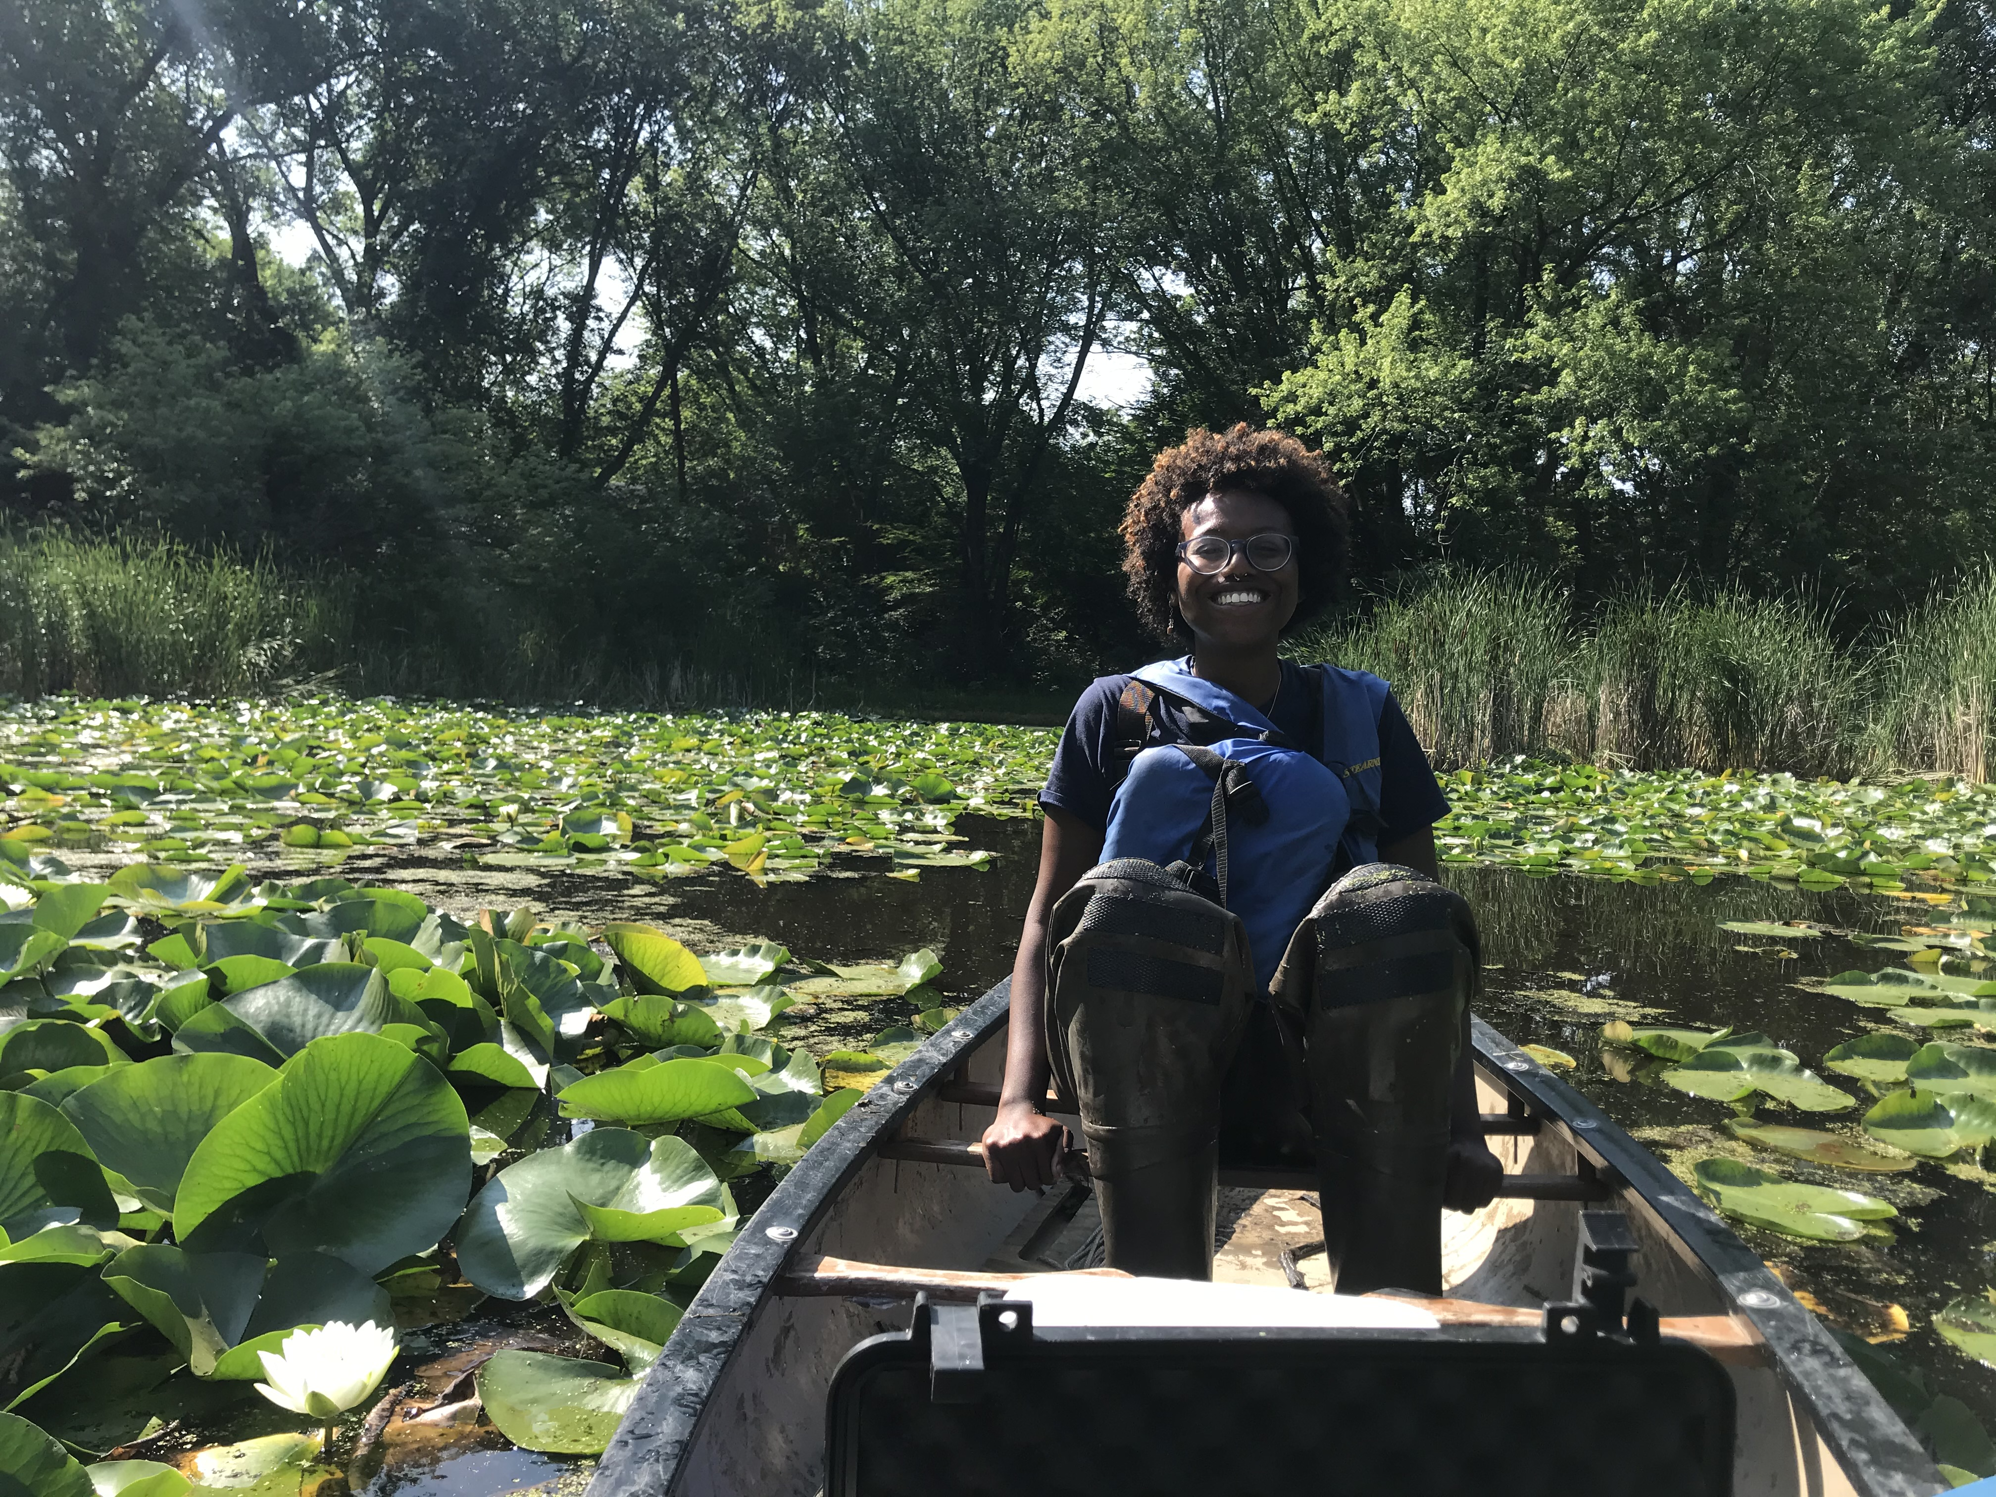
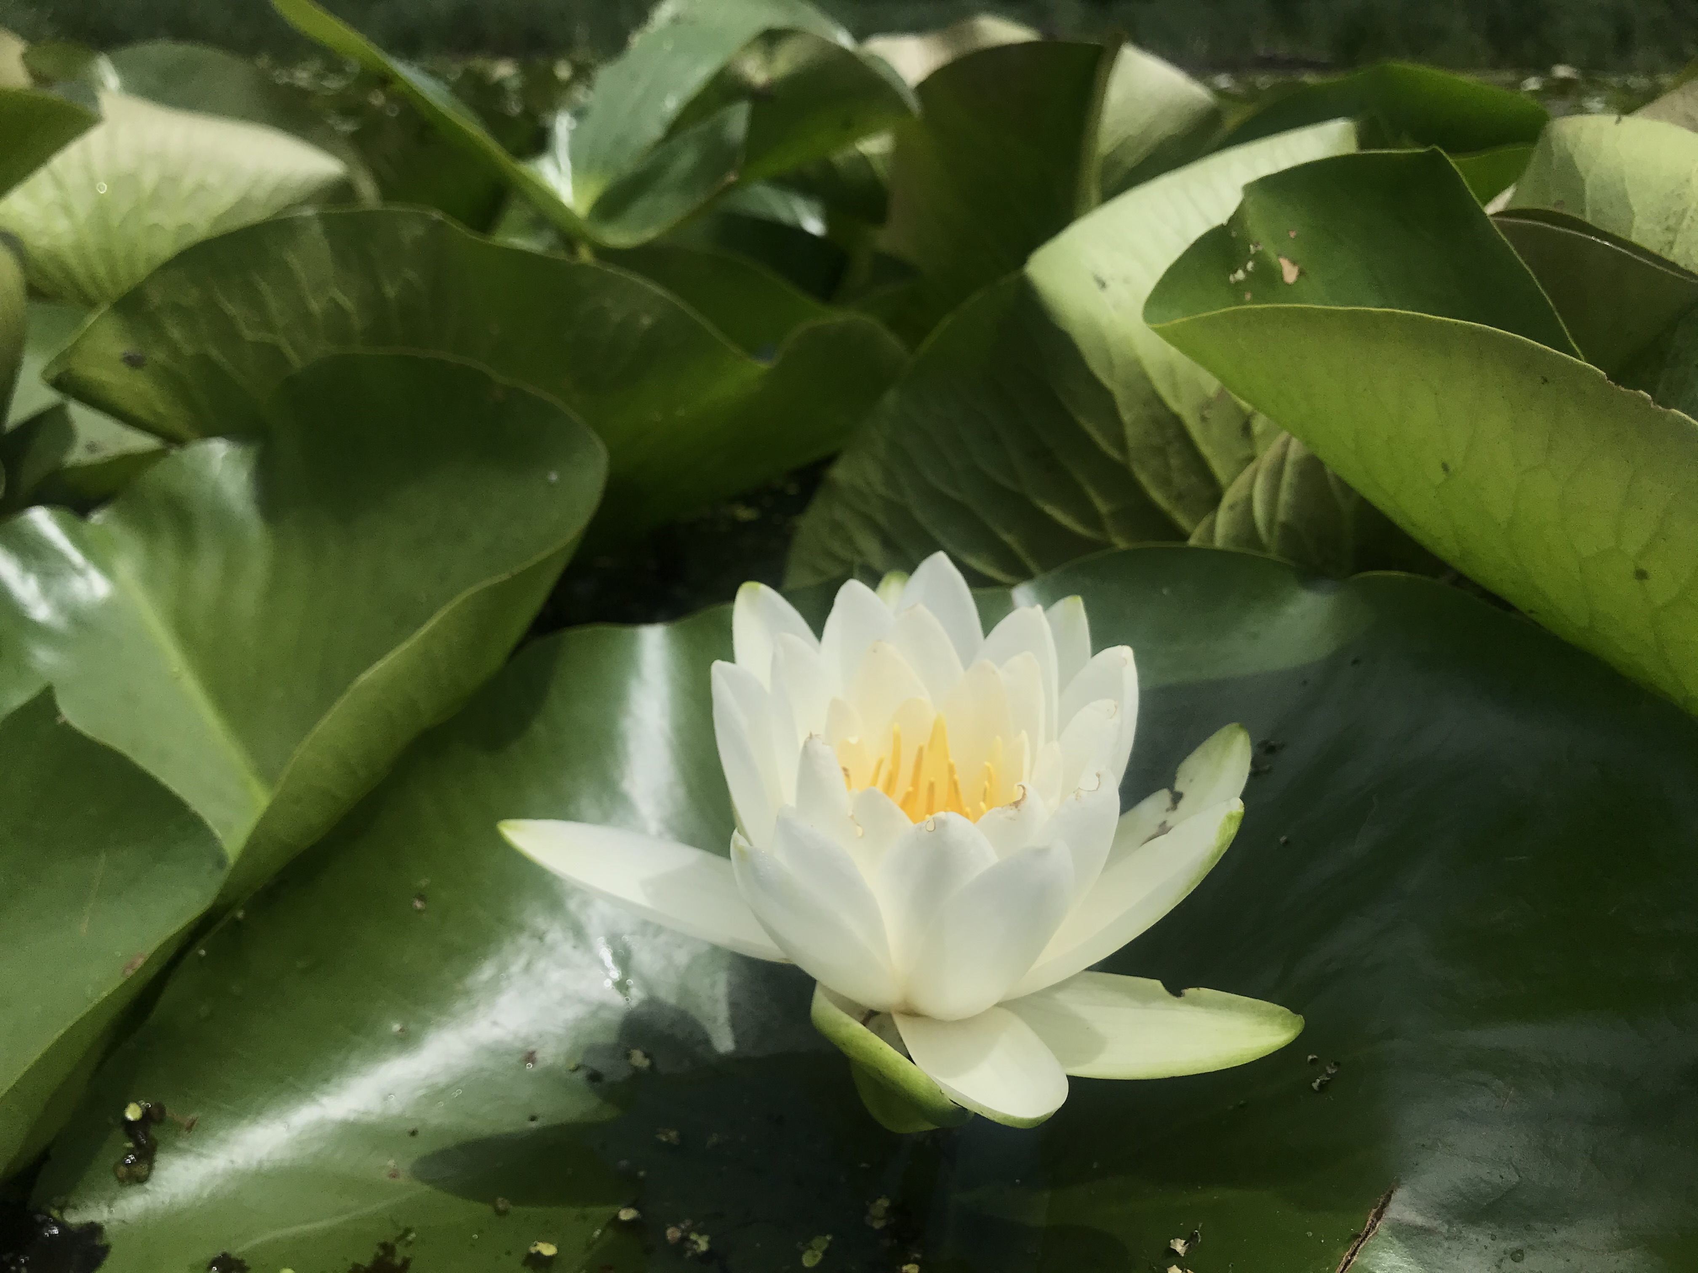
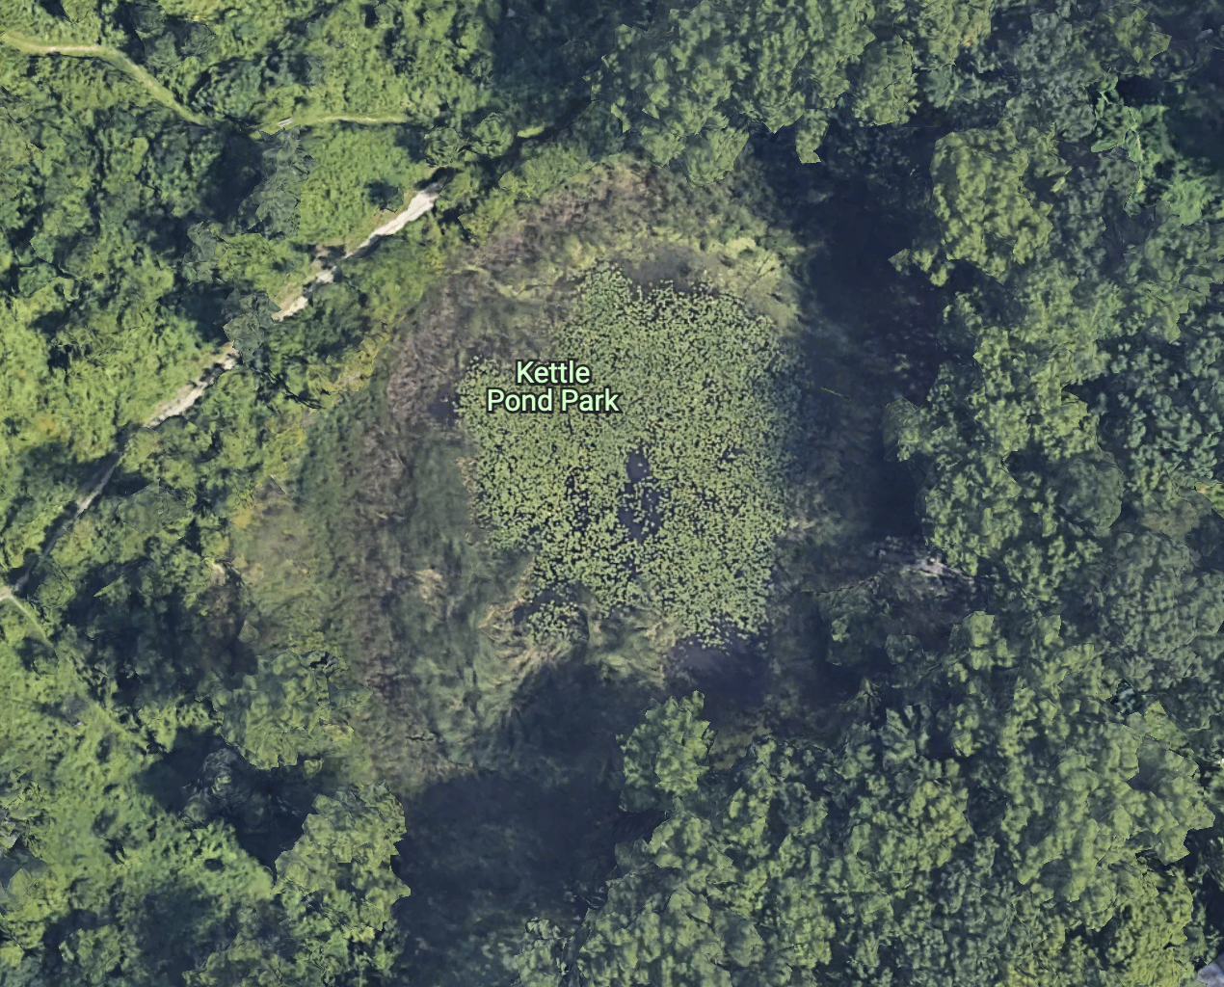
O₂
Hypoxic
Anoxic

Slide 10
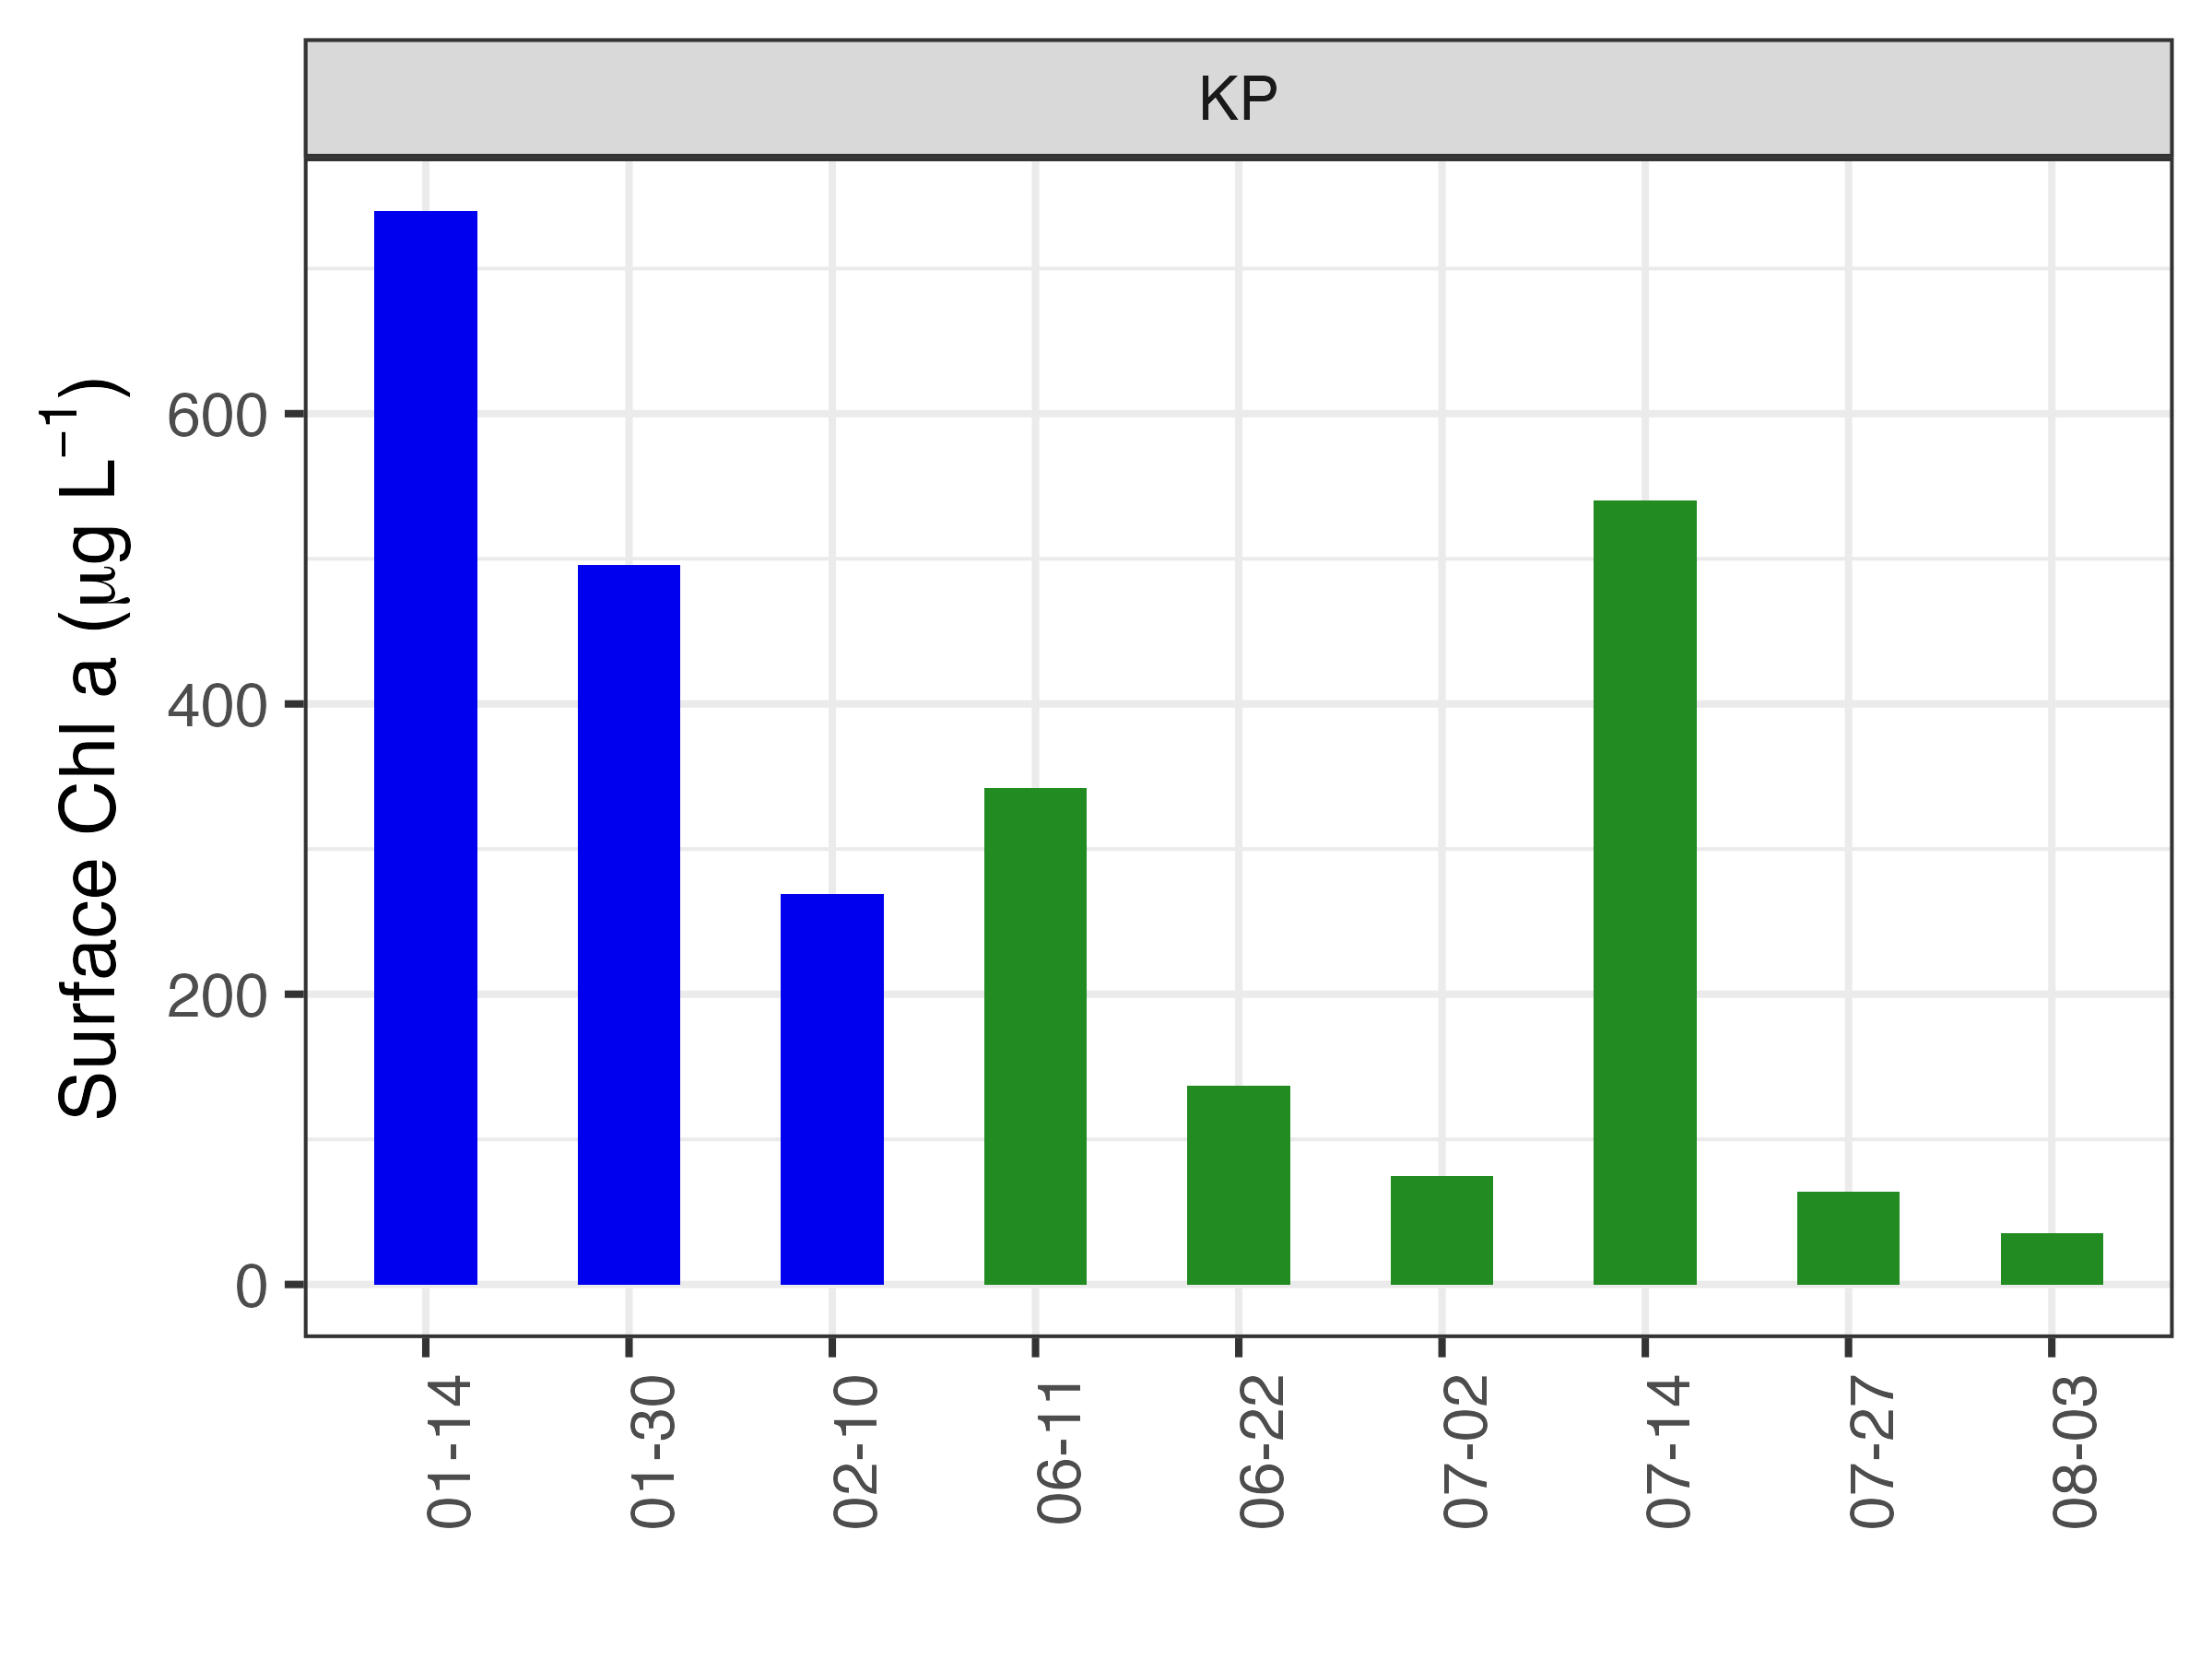
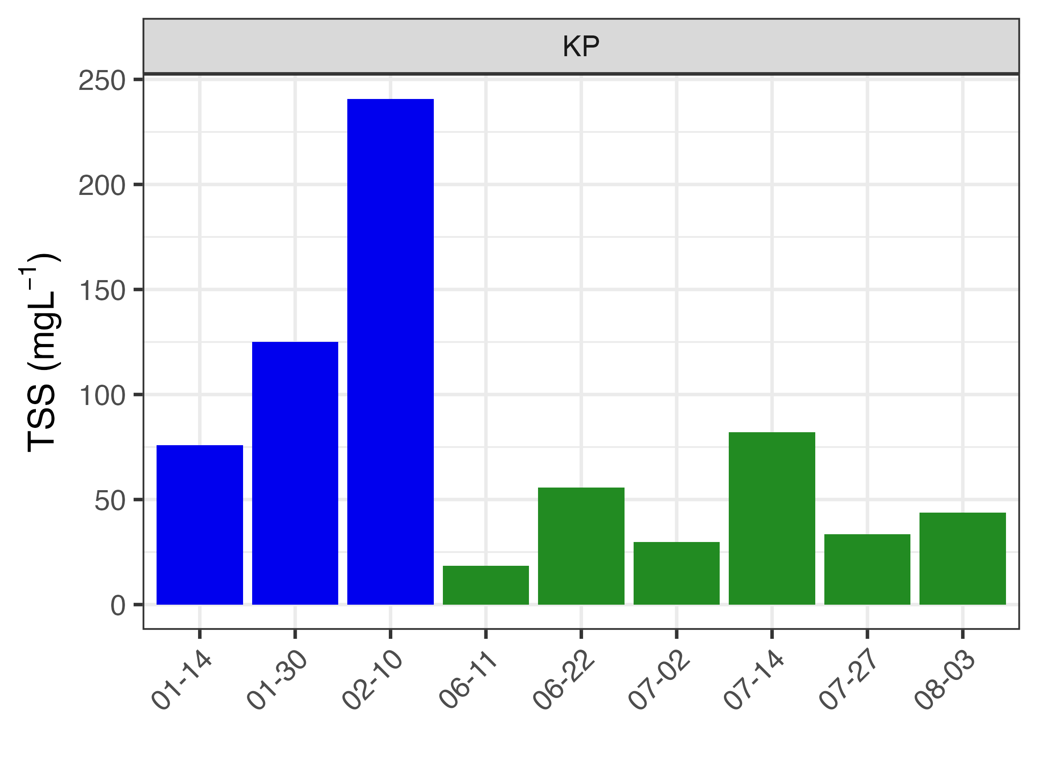
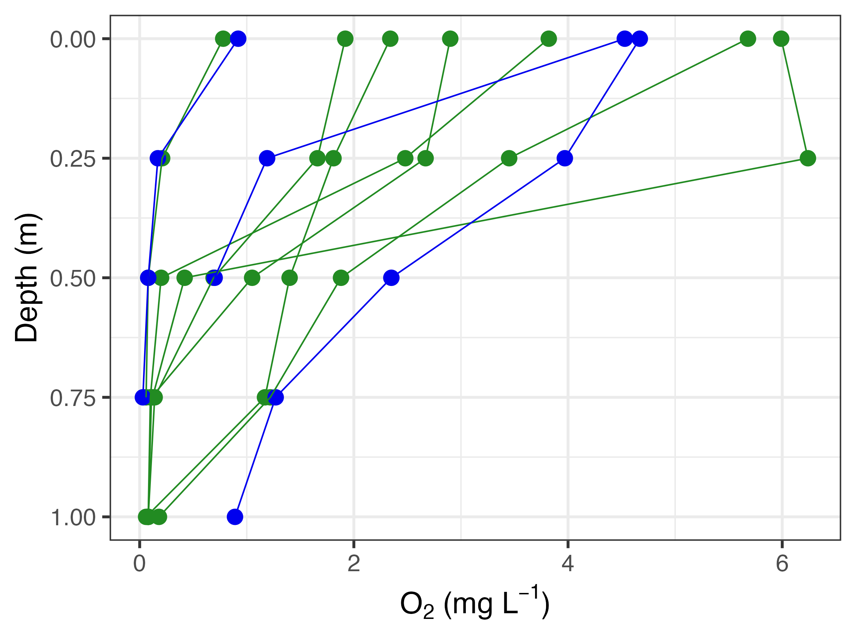
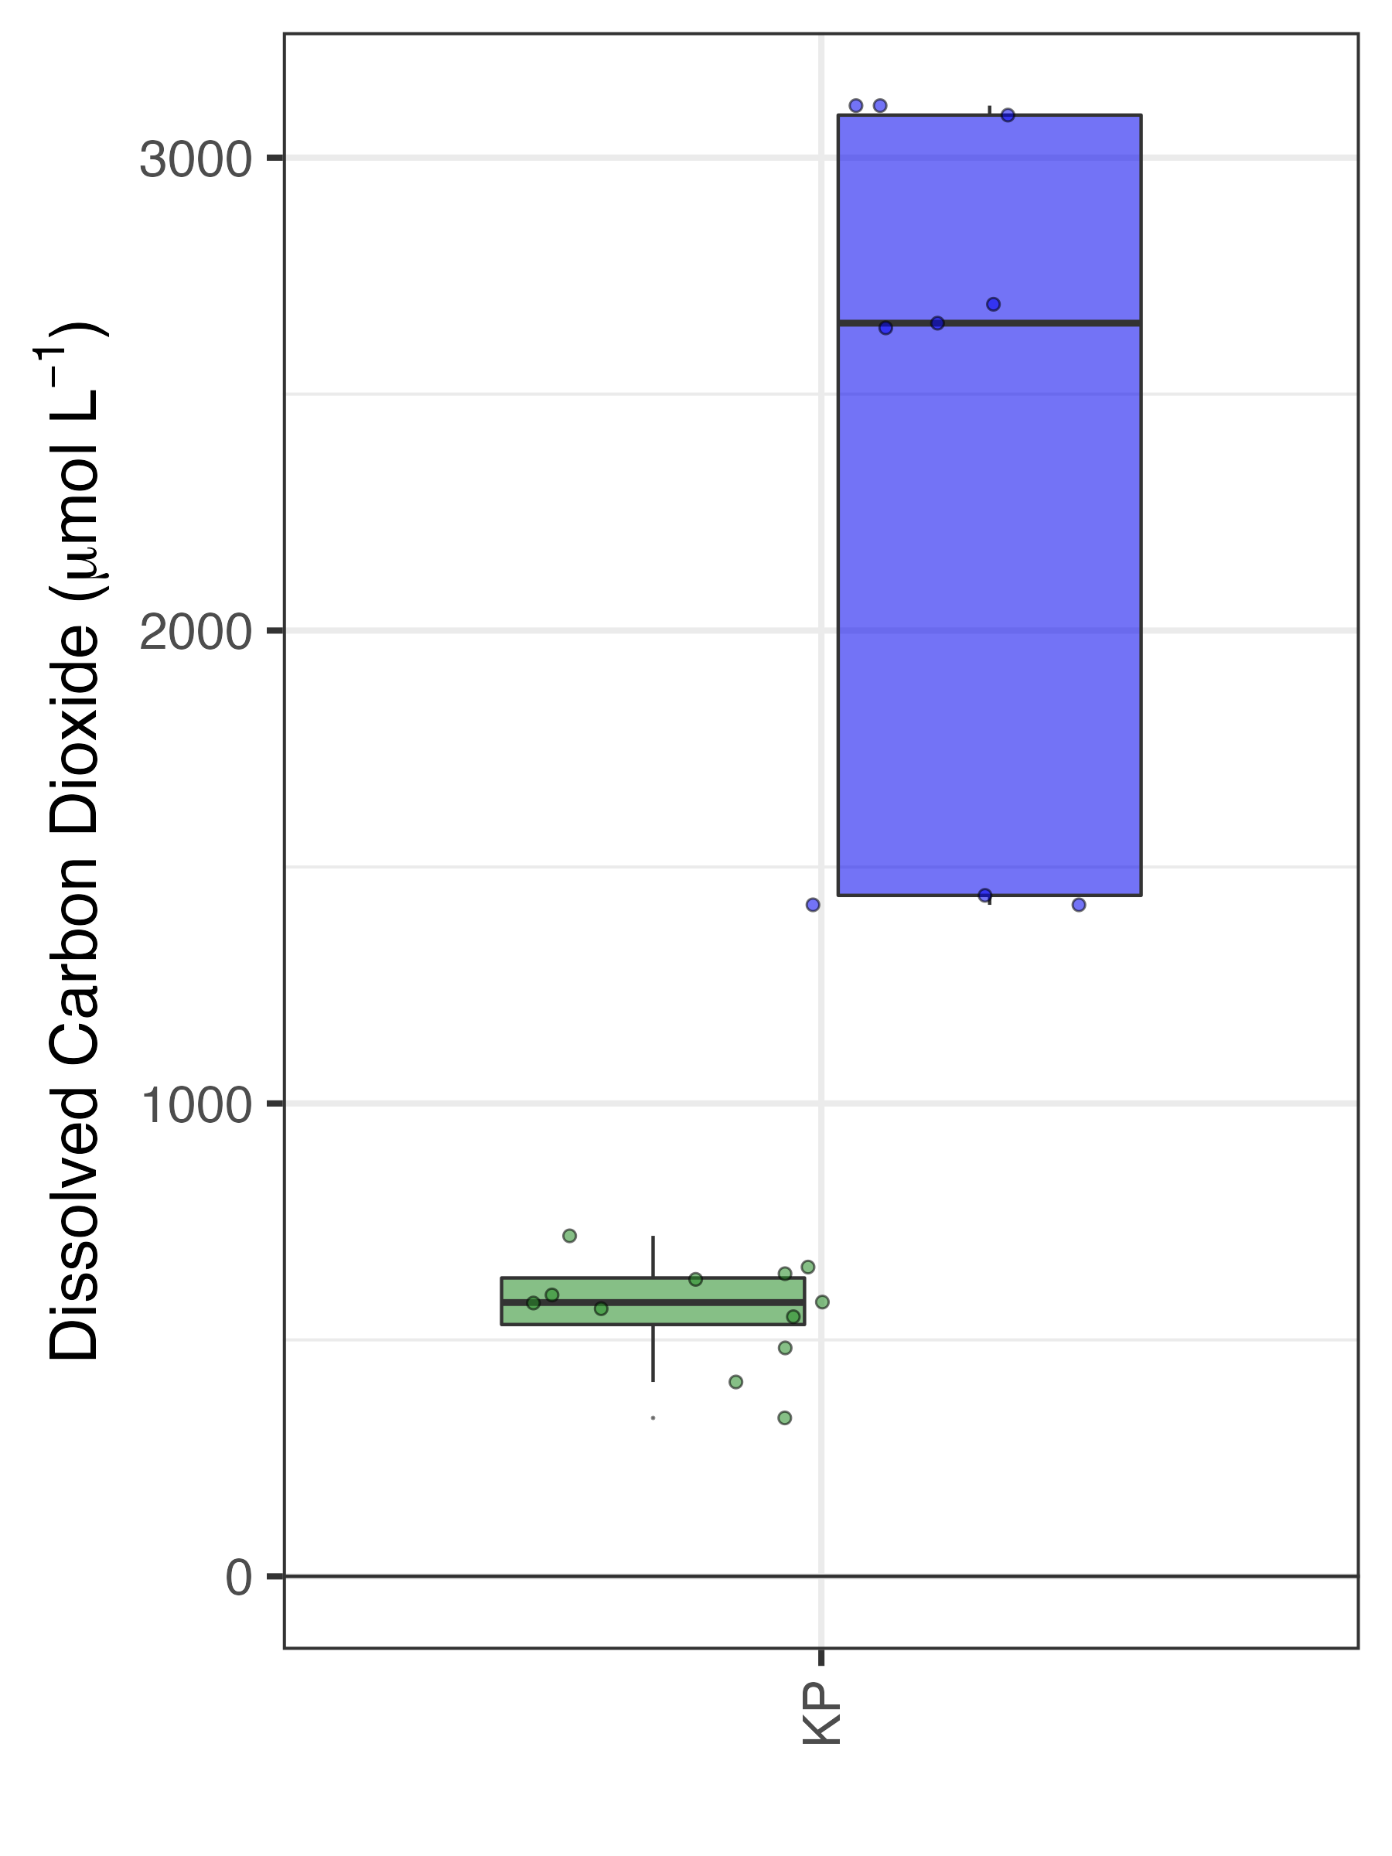
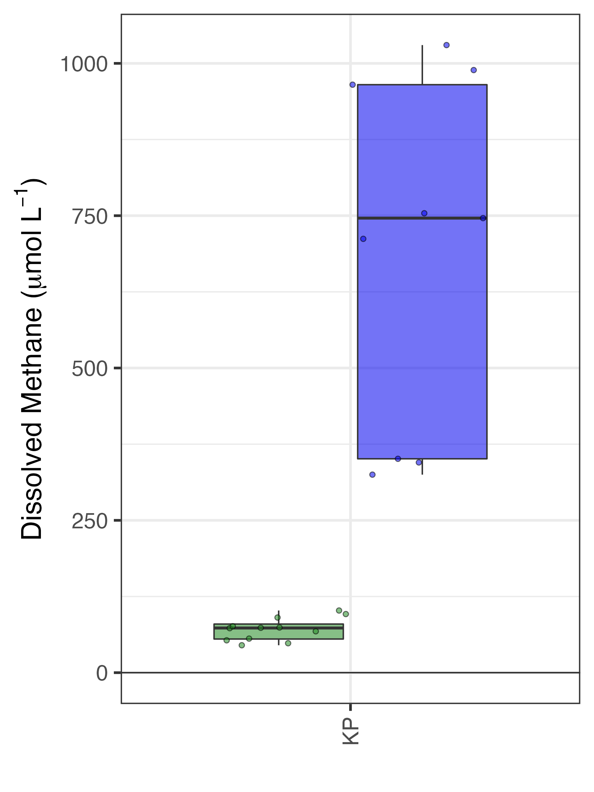
Chla (µgL⁻¹)
Range: 2-549
Median: 35
TSS (mgL⁻¹)
Range: 1.3-82
Median: 15.9
Chla (µgL⁻¹)
Range: 2-1633
Median: 38
TSS (mgL⁻¹)
Range: 1-241
Median: 9.9
Hypoxic -Anoxic

Slide 11
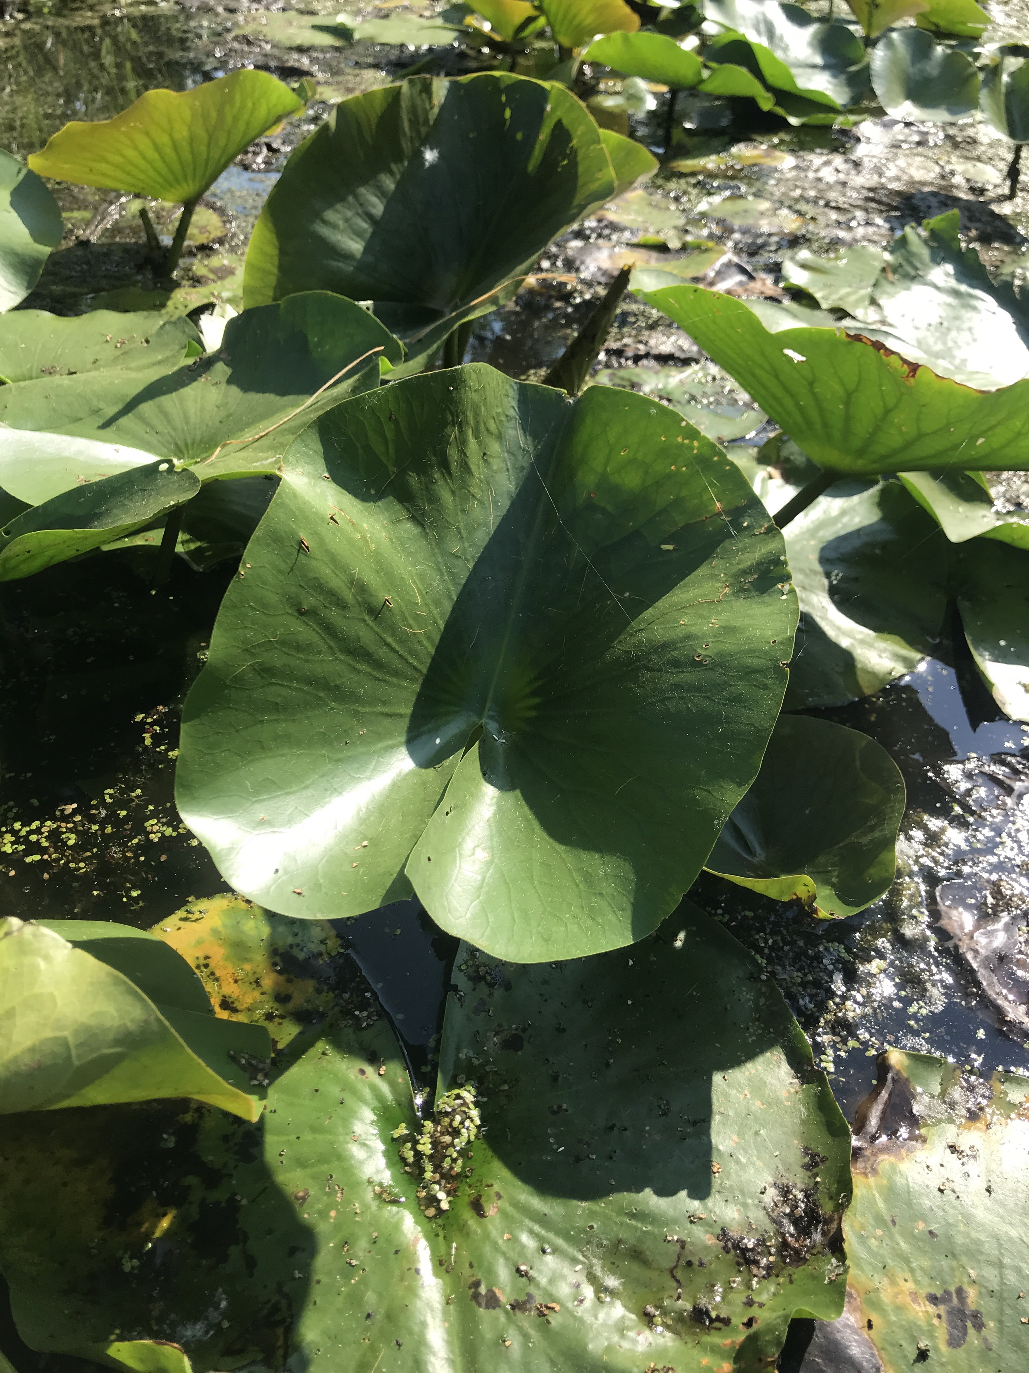
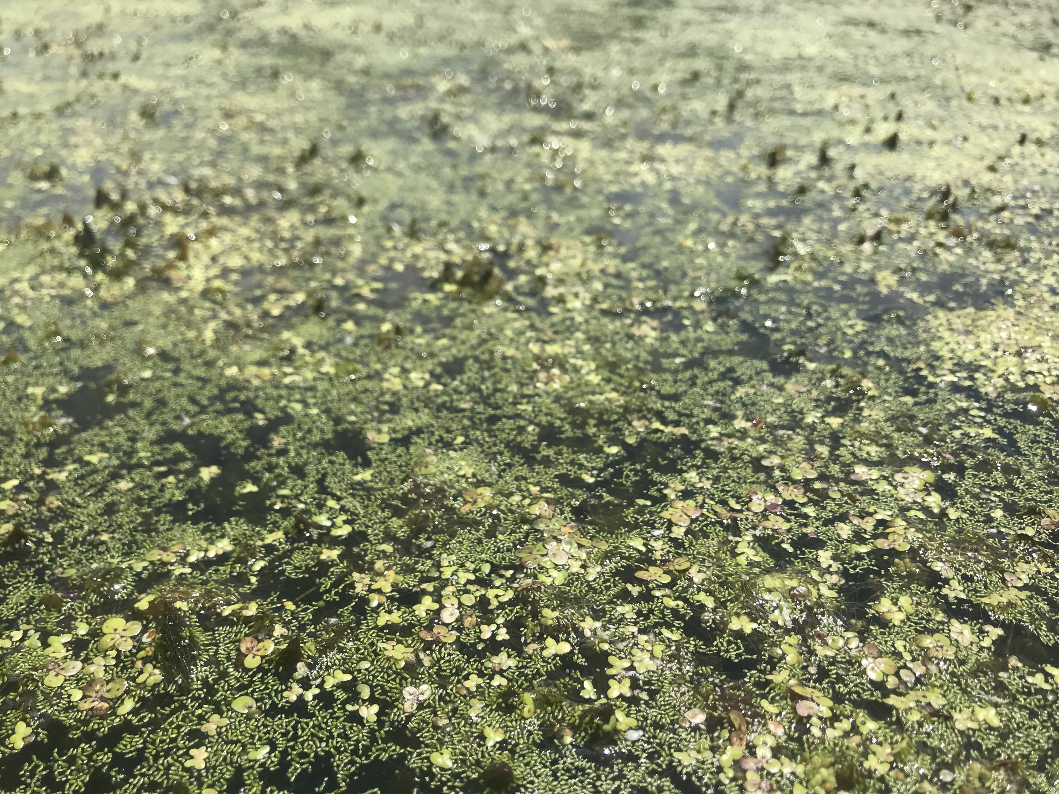
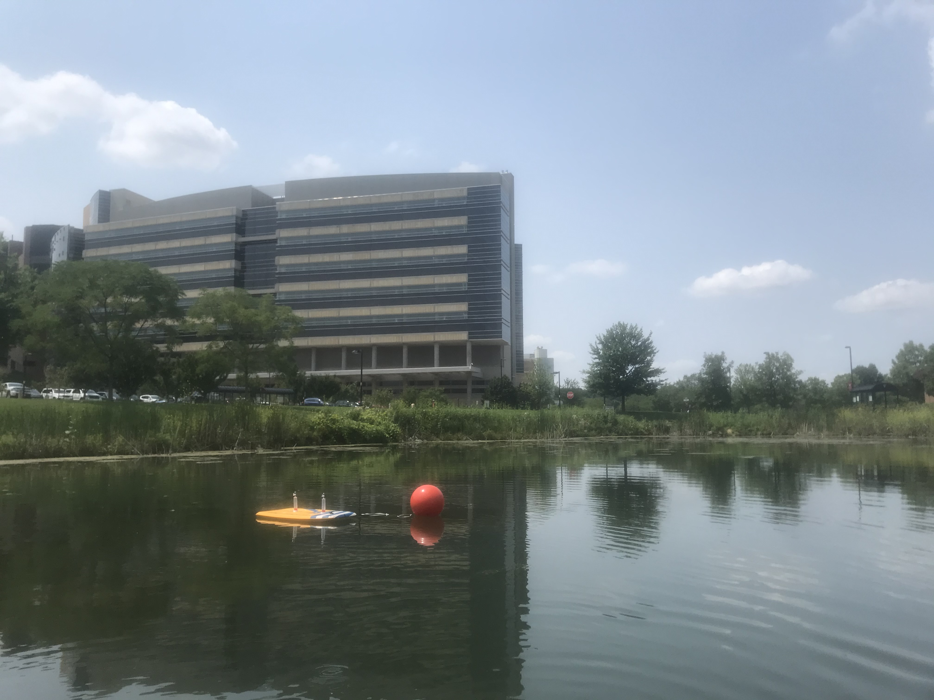
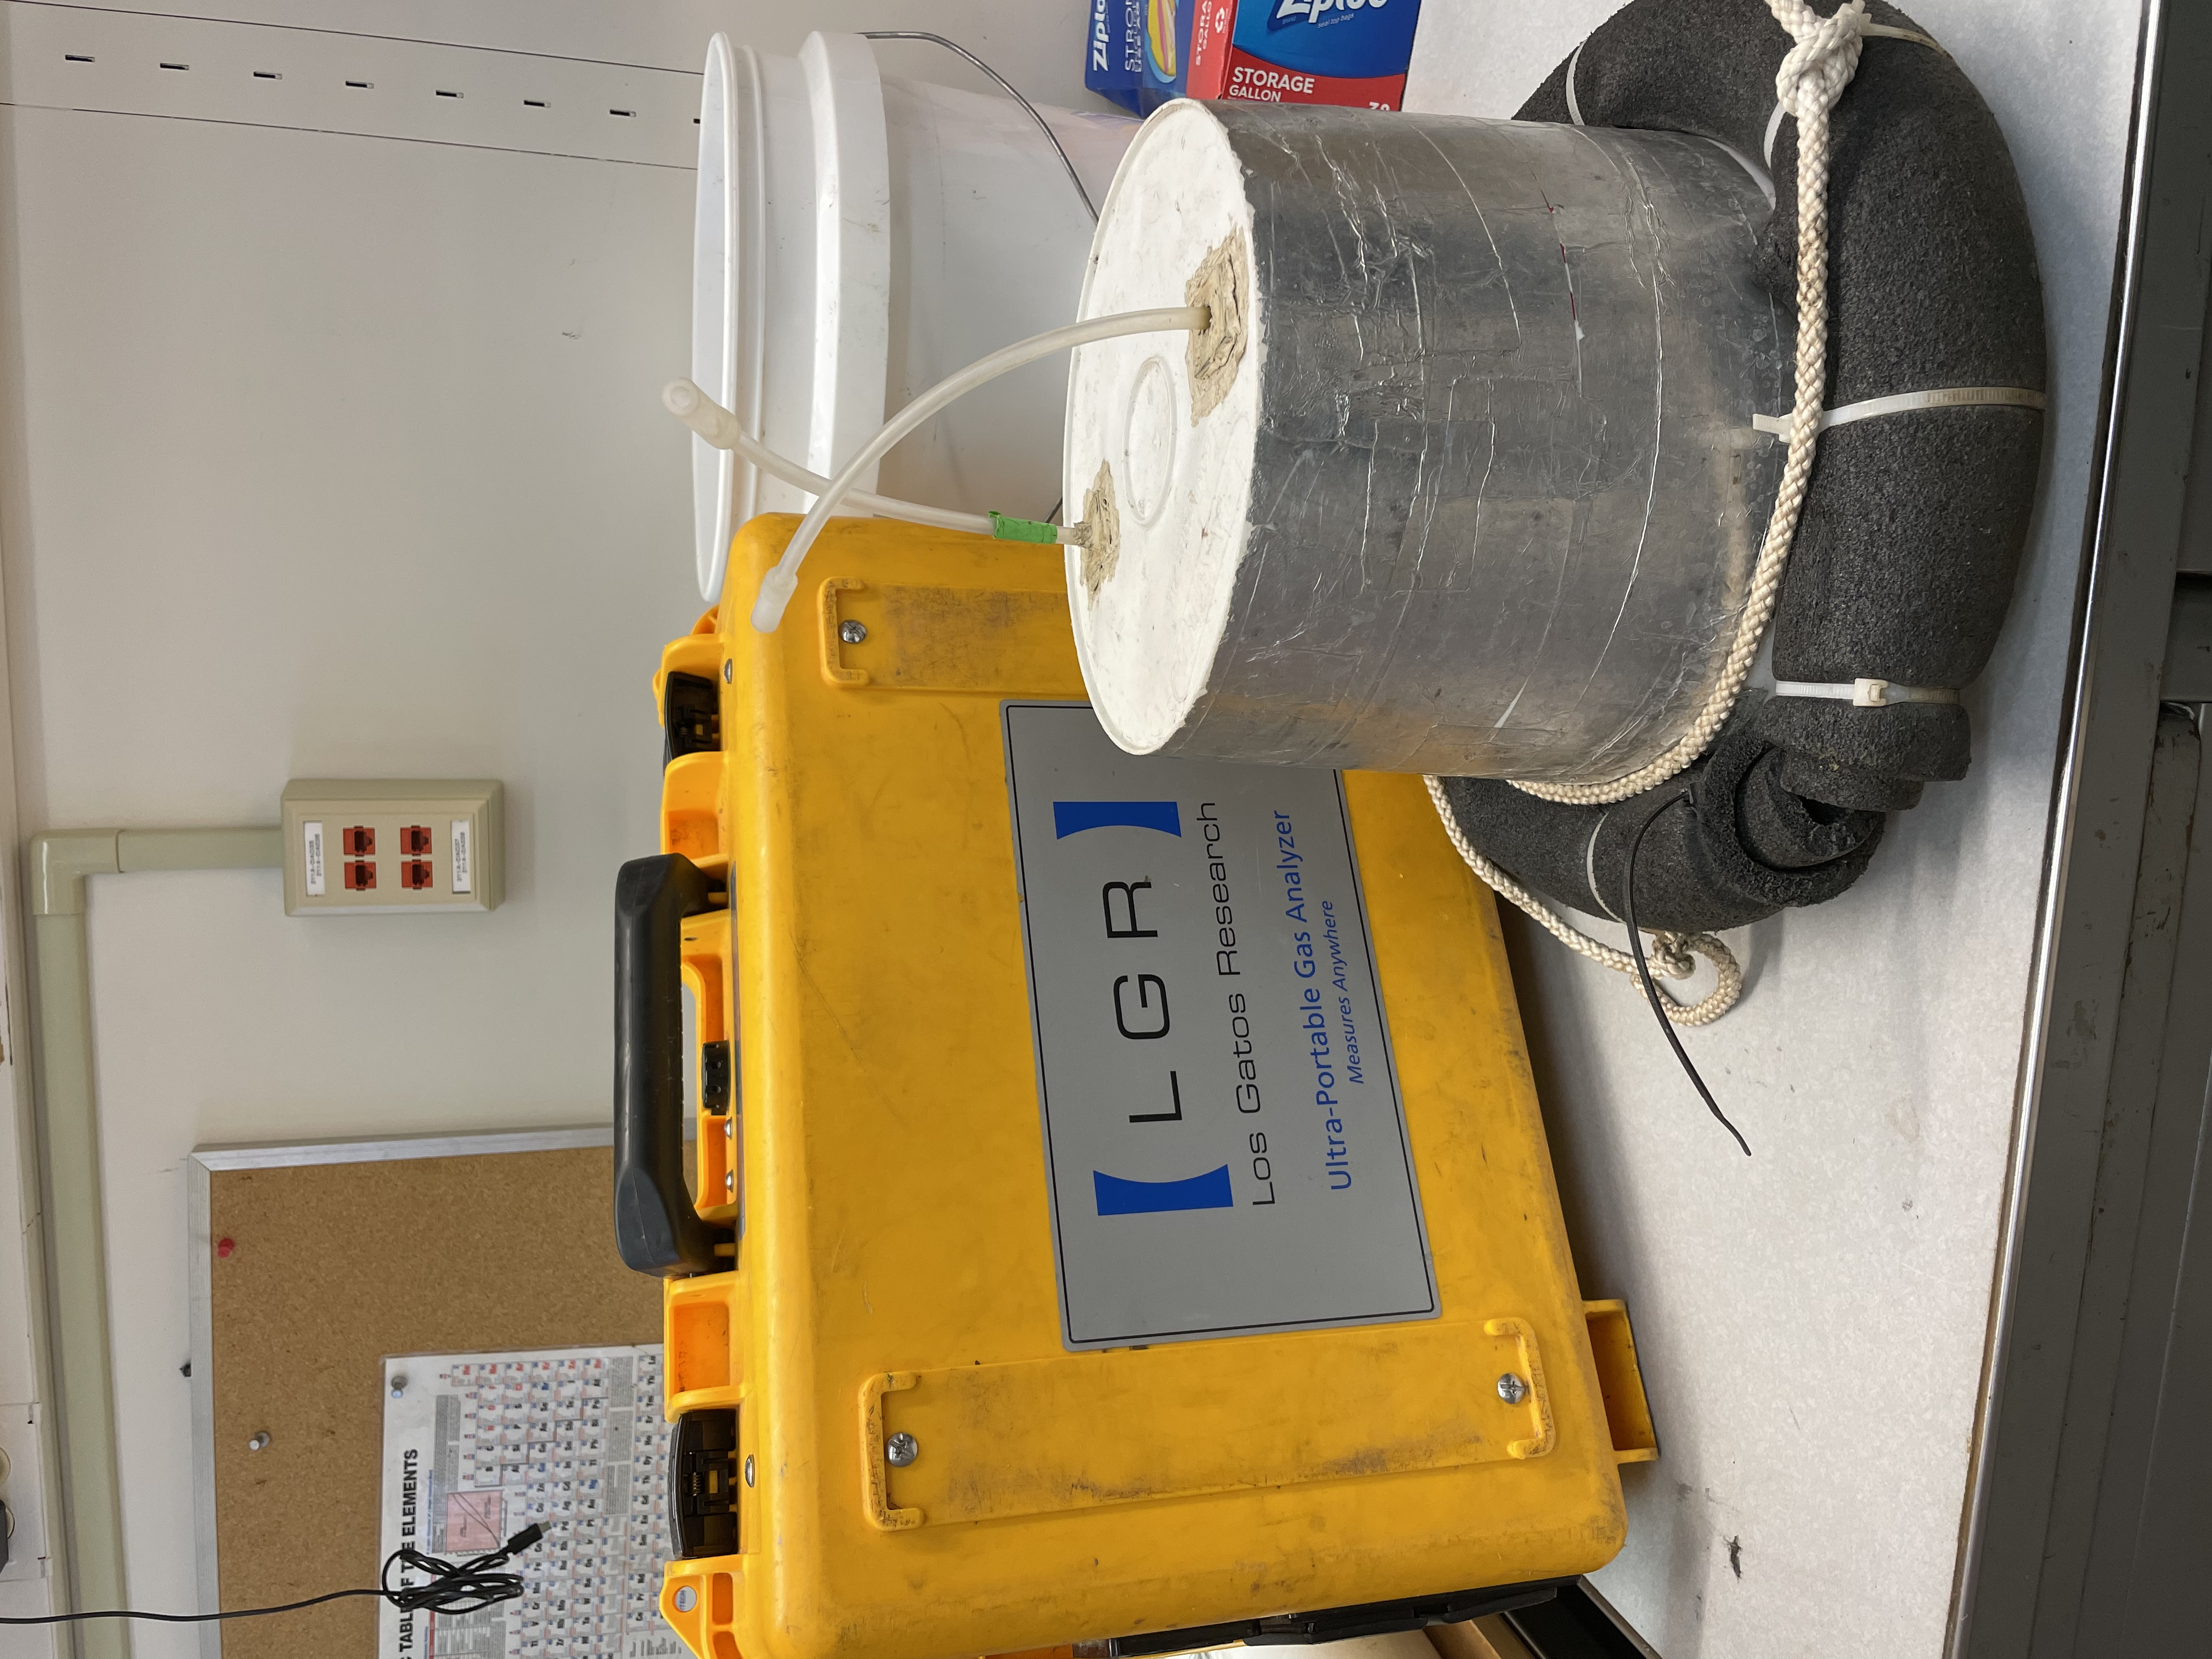
Conclusion
Lots of variation between ponds
Higher concentrations during the winter
Macrophytes, morphological differences, land cover
Shoulder seasons
Estimates of all production types
Within pond heterogeneity
Future Focus

Slide 12
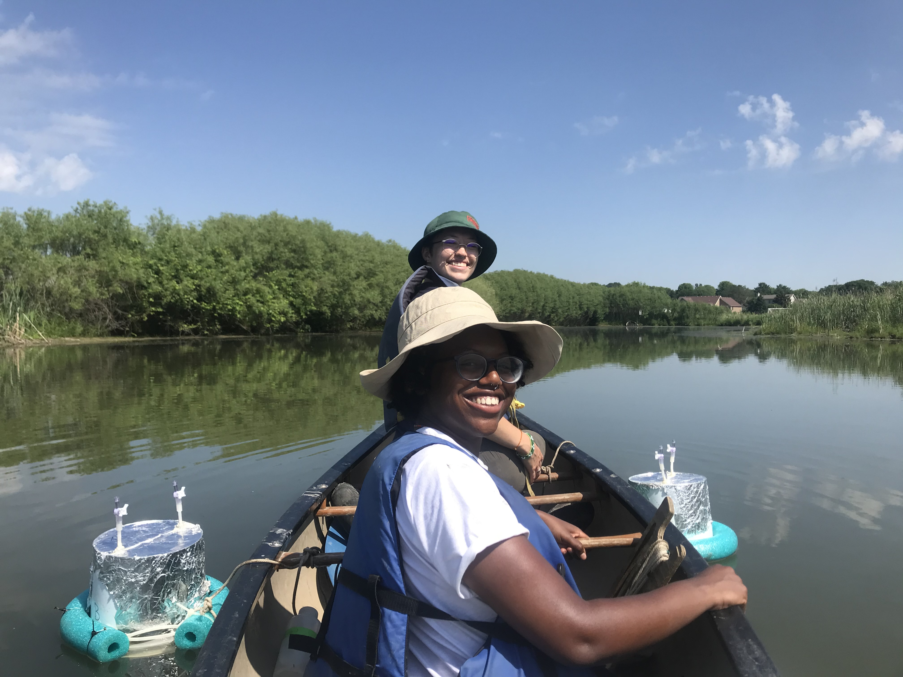
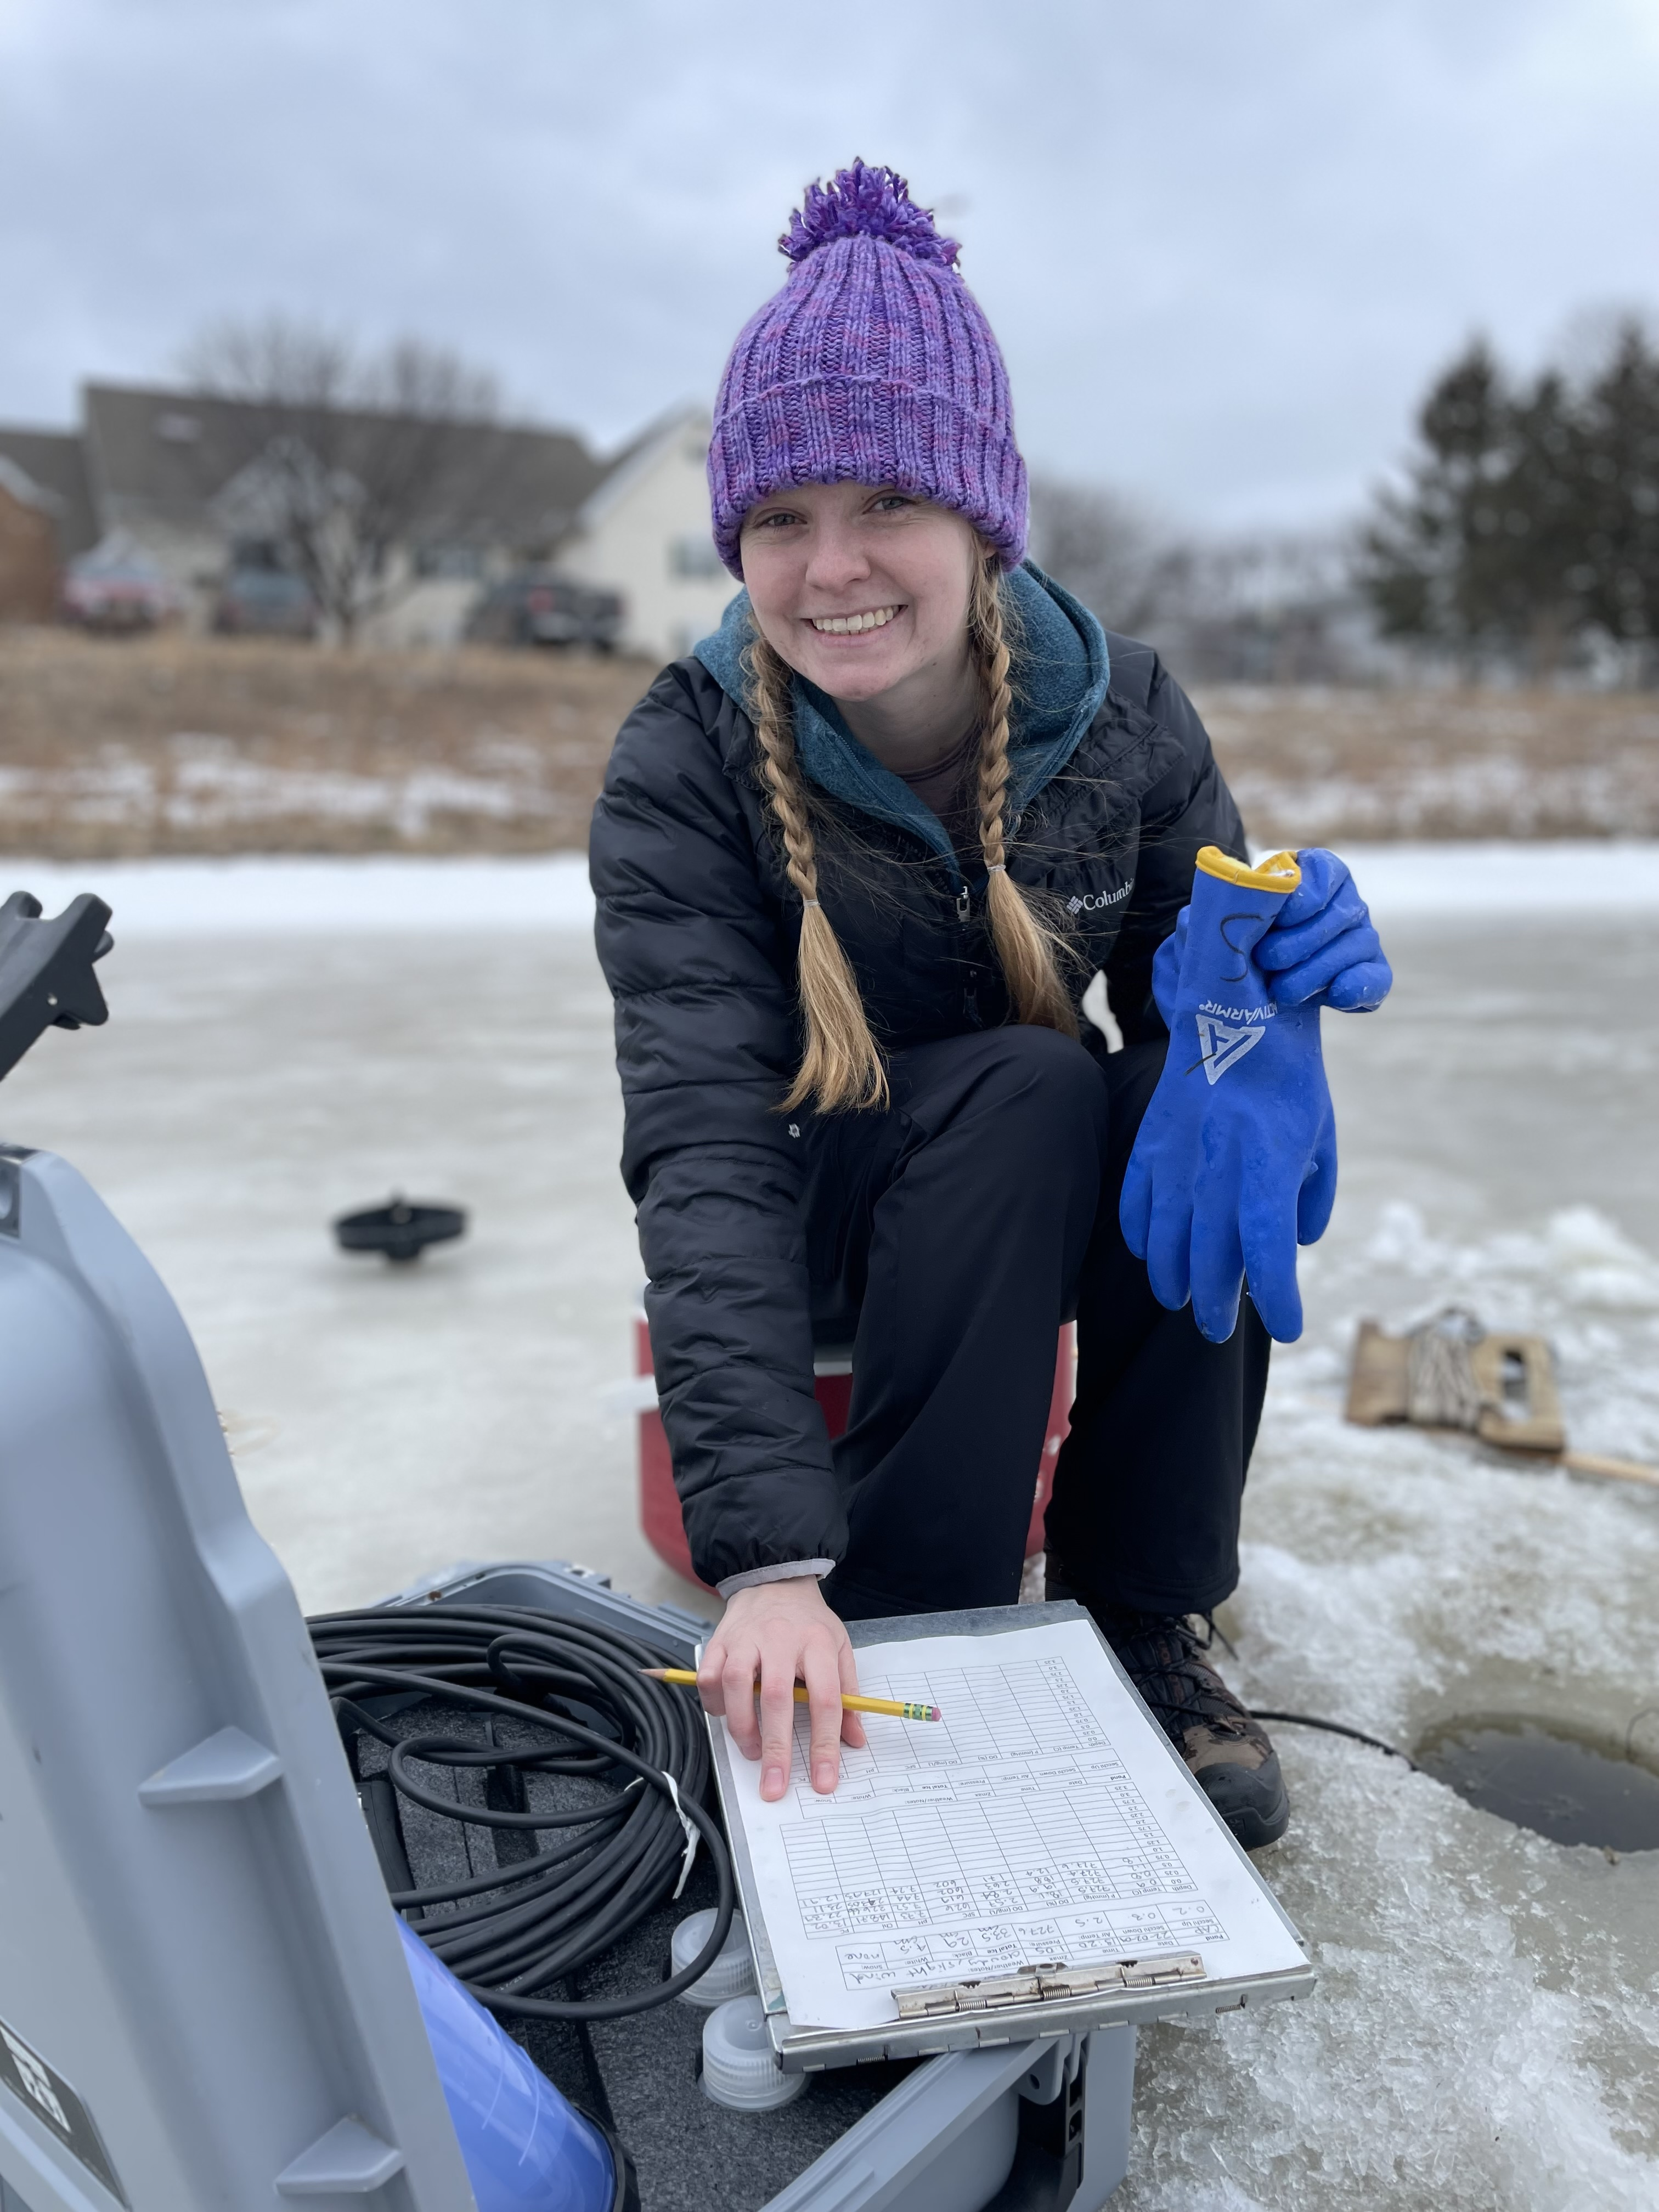
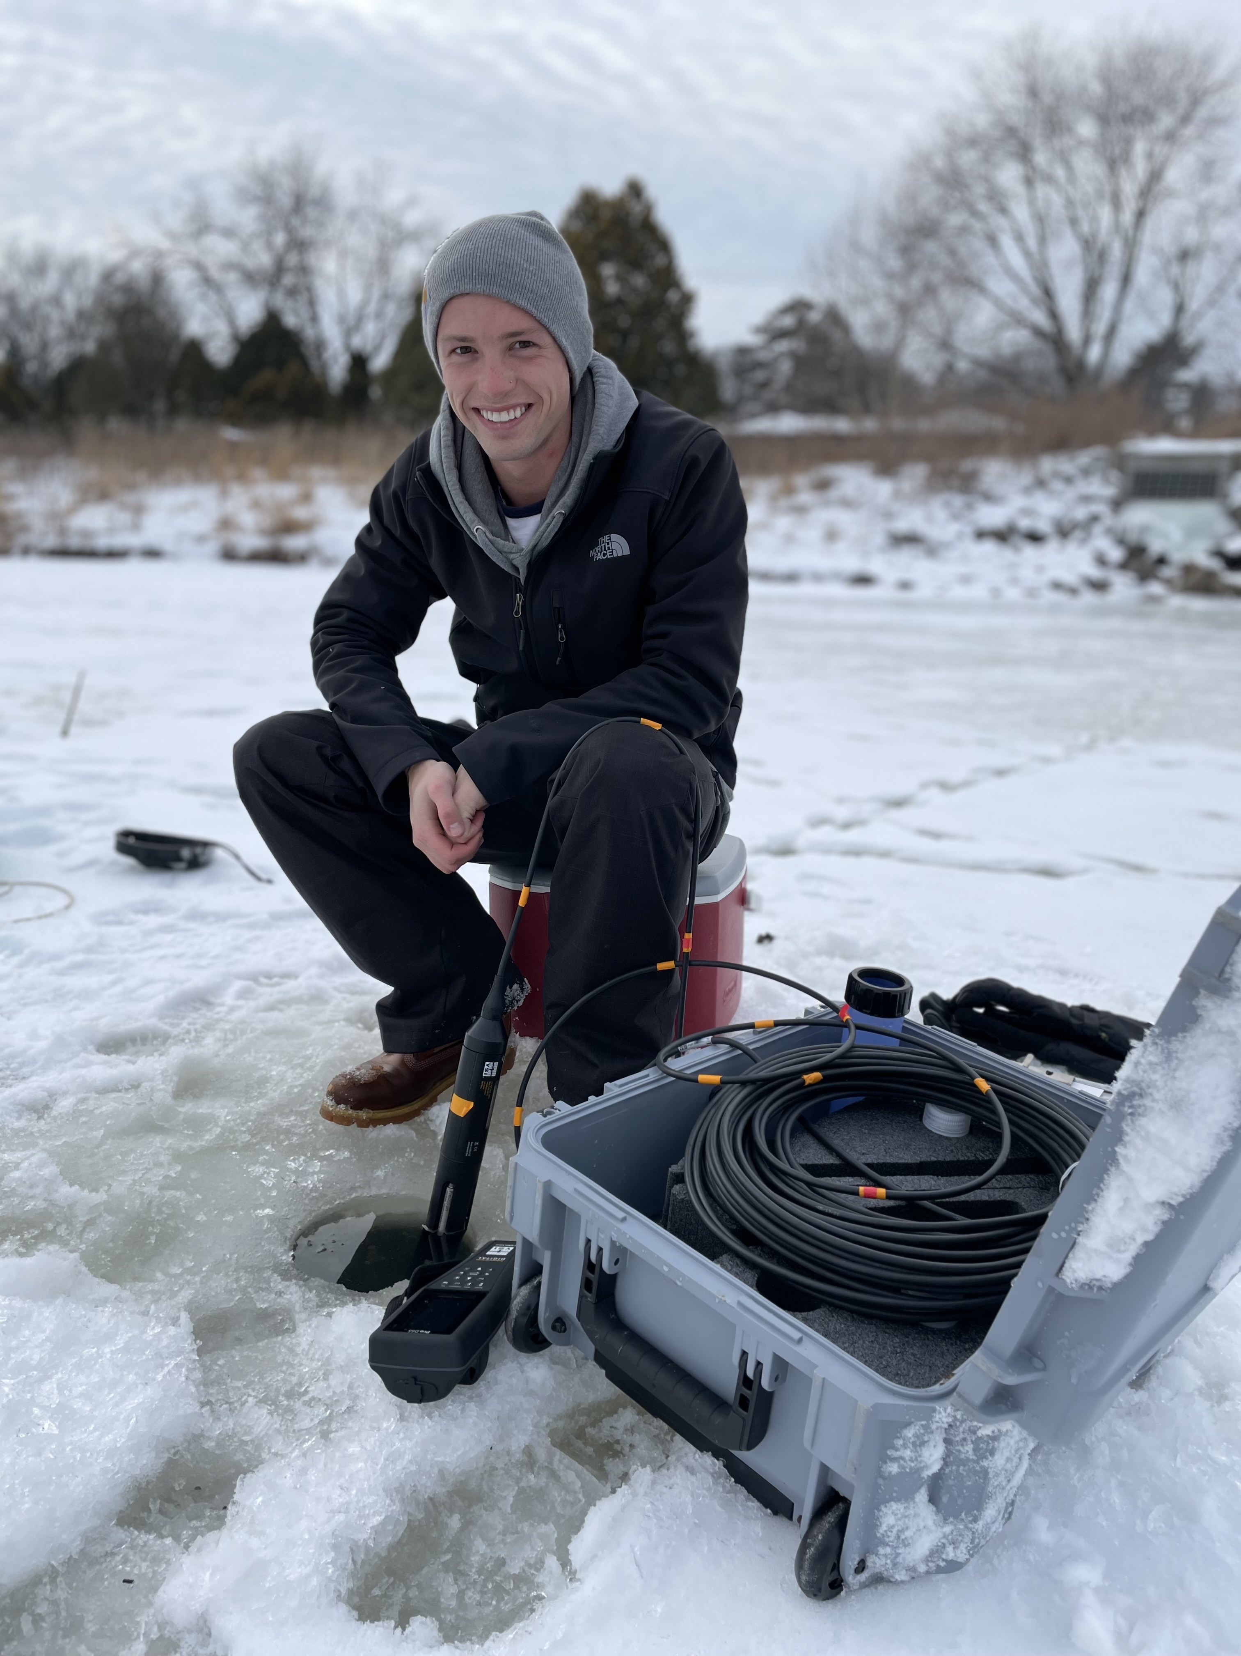
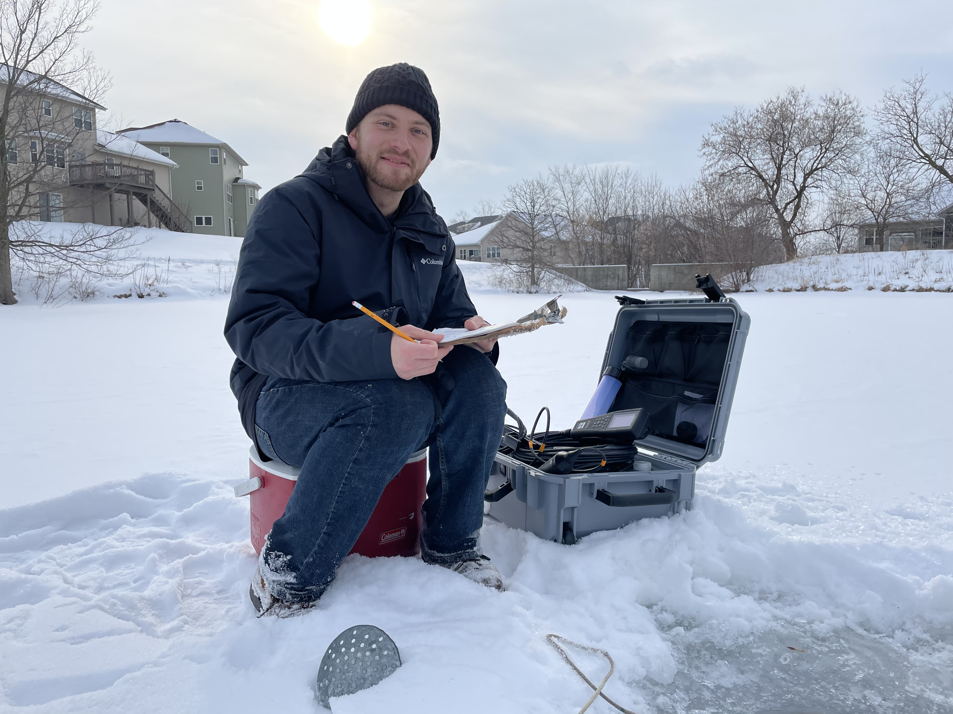
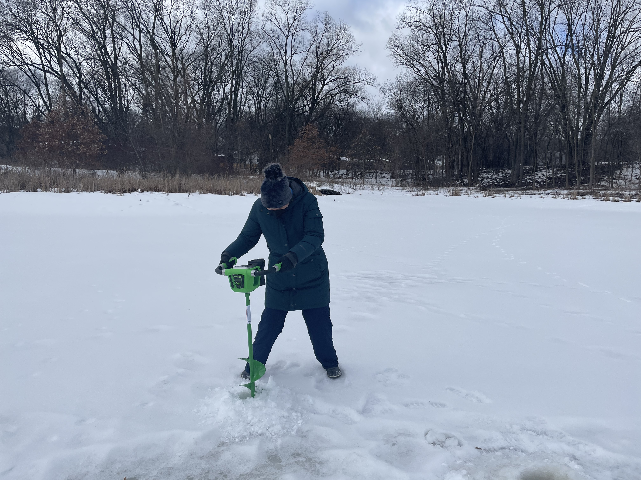
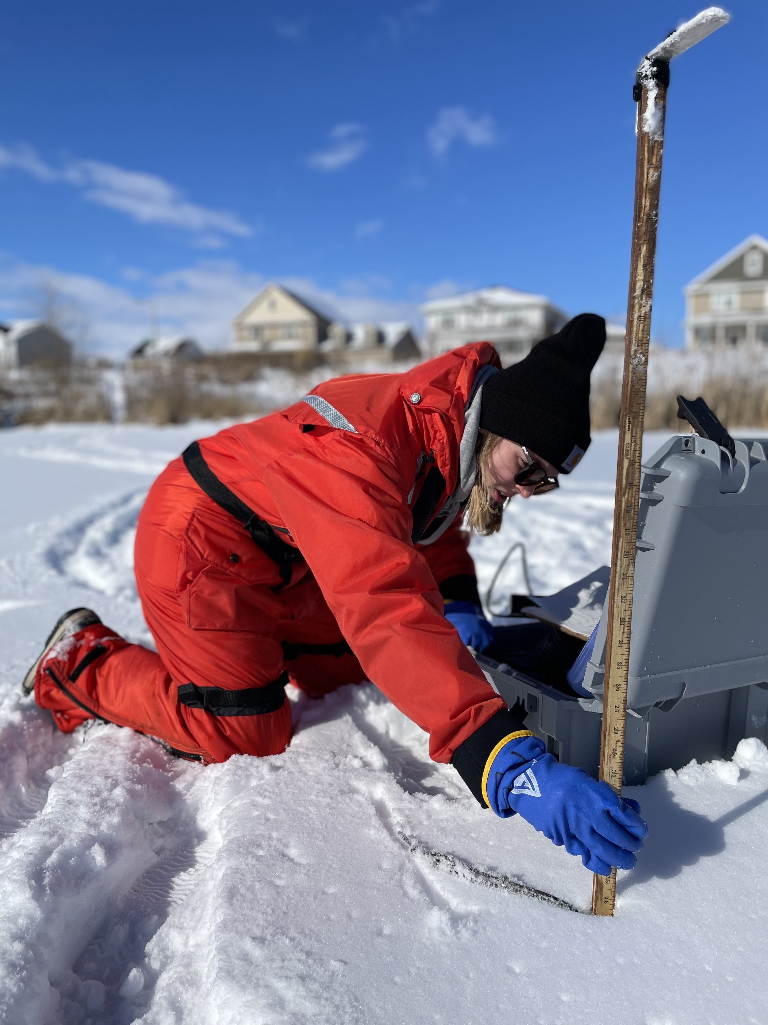
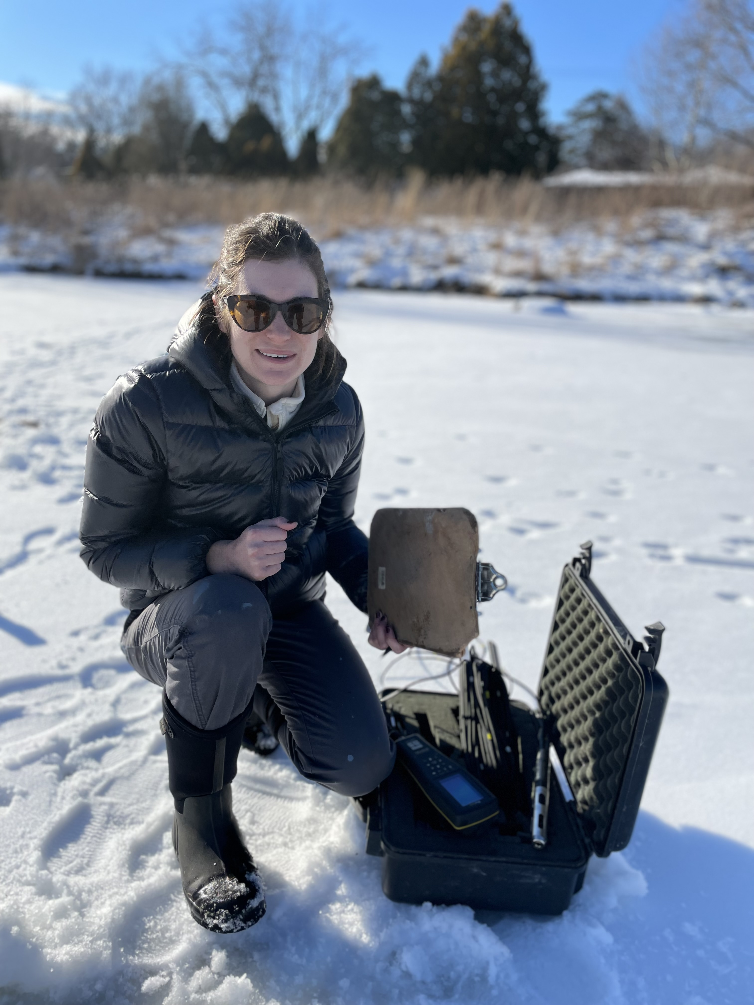
Acknowledgements
Urban Pond Collaborators:
Daniel Trovillion, Ella Schmidt, Jess Briggs, Helen Schlimm, Grace Wilkinson
Undergraduate Technicians:
Kendi Aaron and Emma Donohue
Winter Volunteer Extraordinaires:
Holly Embke, Ellie Socha, Olivia Nyffeler, Adam Rexroade, Danny Szydlowski, Helen Schlimm
David Ortiz, Vince Buttita, Adam Rexroade, Ellie Socha

